Slide 1
Deep Learning Illustrated
Slides used for teaching:
Ch. 3
Ch. 12
Ch. 4
Ch. 13-14

Slide 2
Chapter 3

Slide 3
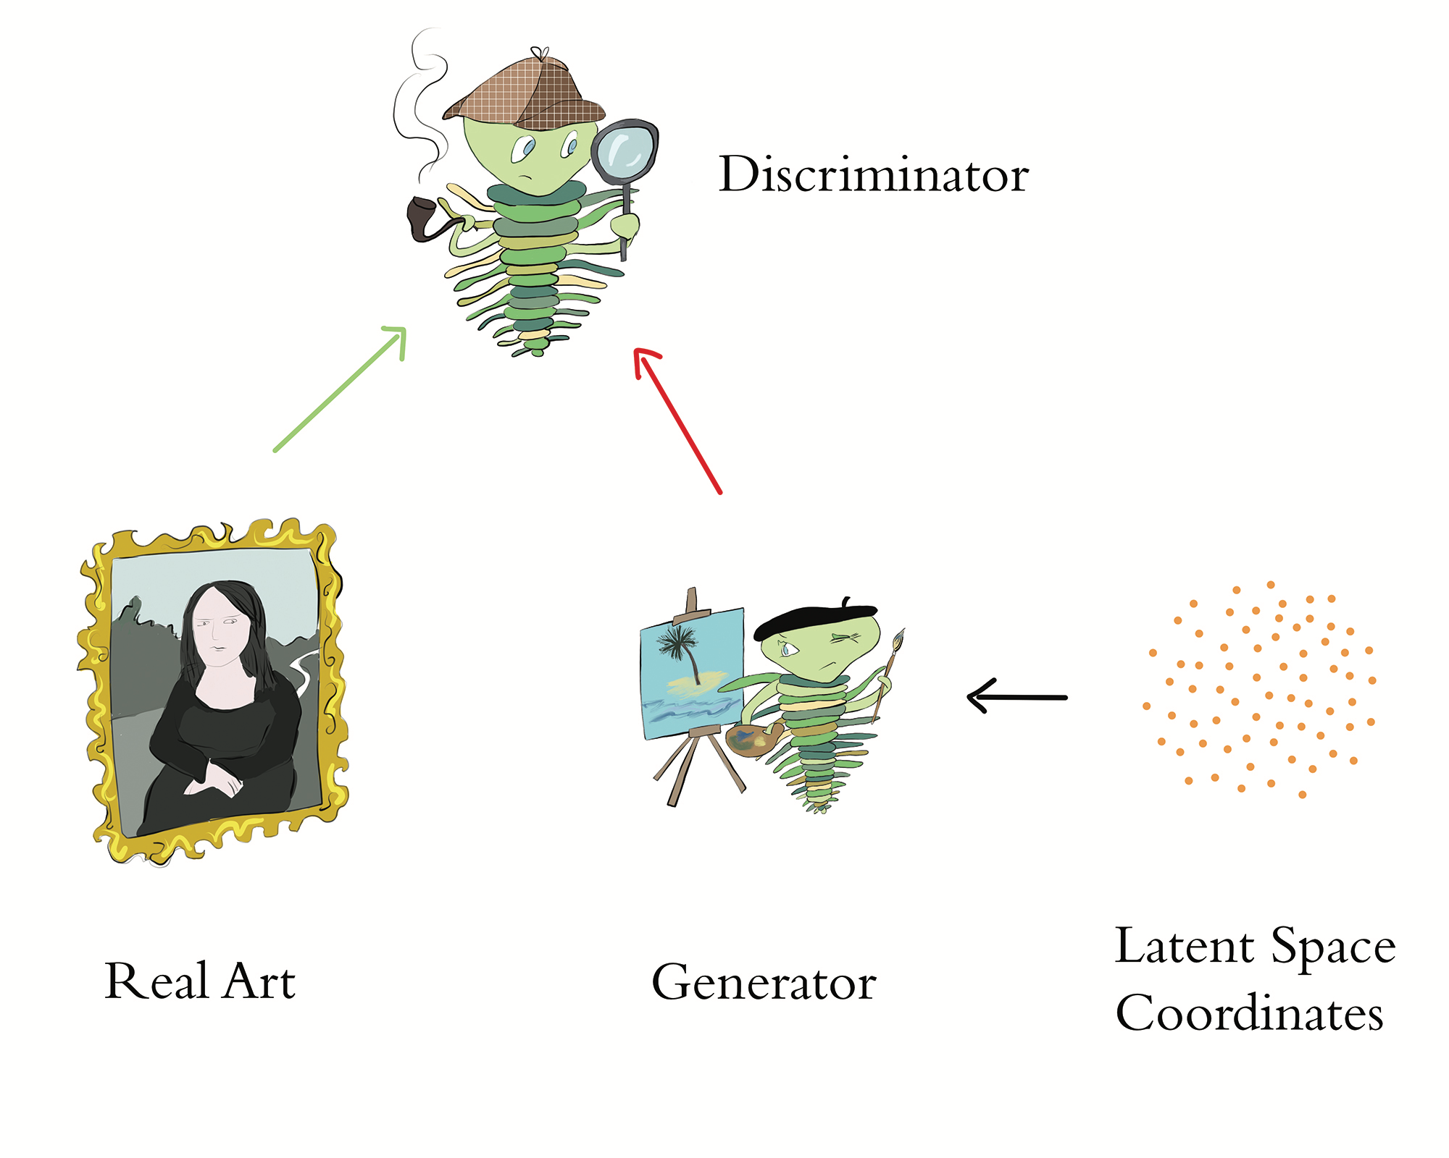

Slide 4
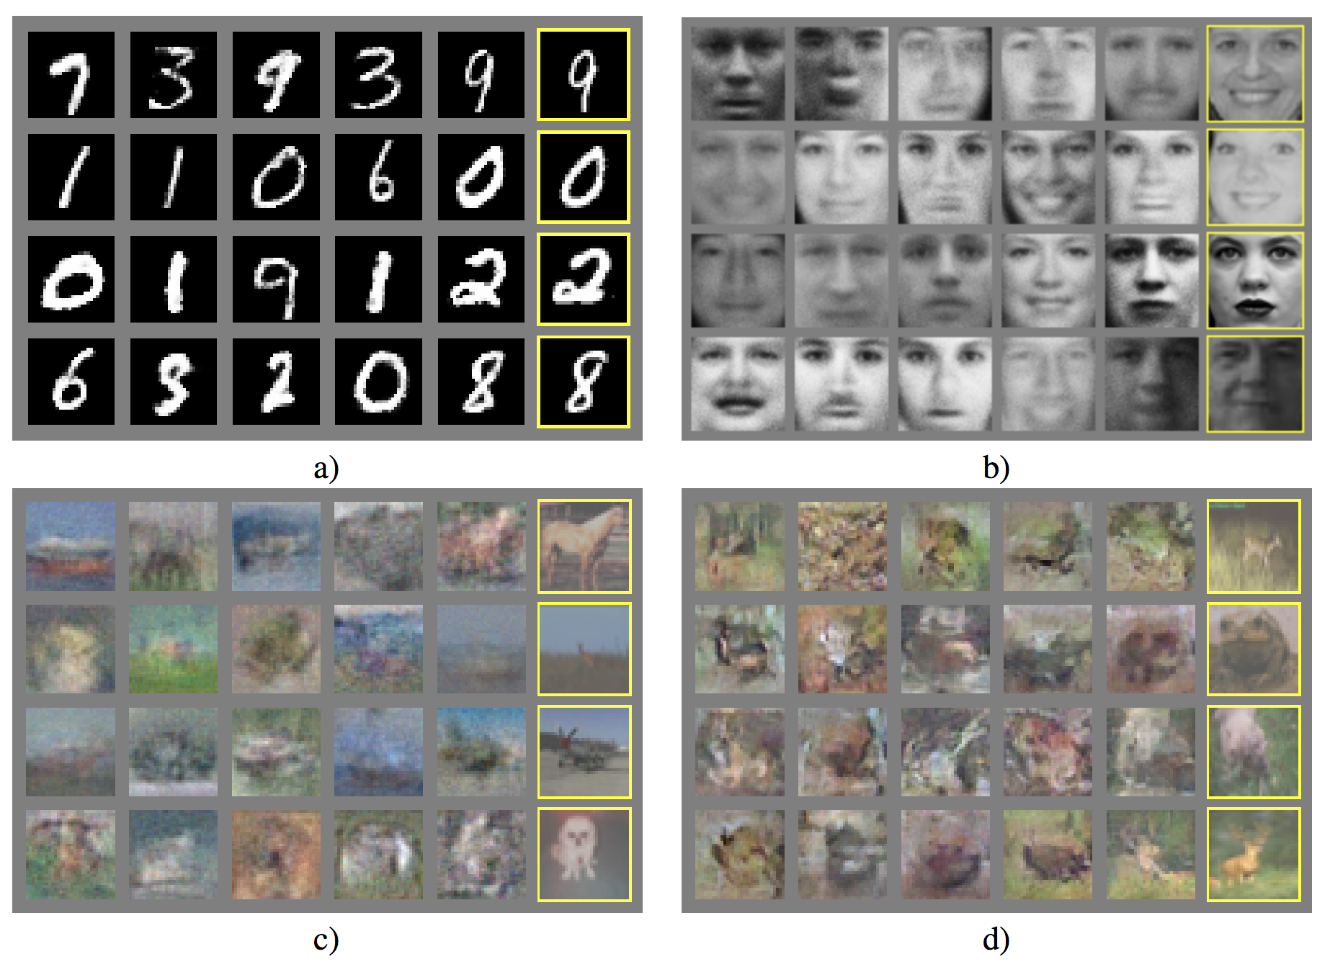
GANs (Goodfellow et al., 2014)
arXiv: 1406.2661

Slide 5
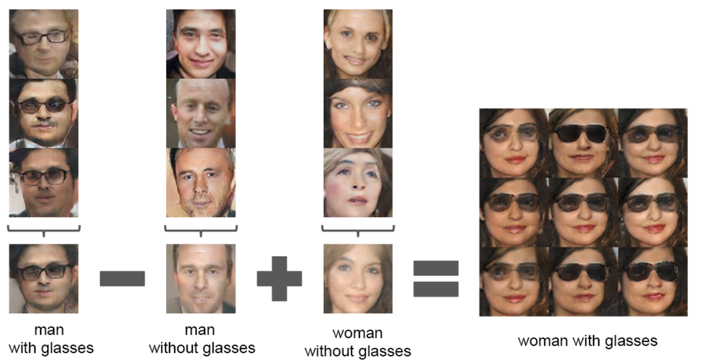
DCGANs (Radford et al., 2016)
arXiv: 1511.06434

Slide 6
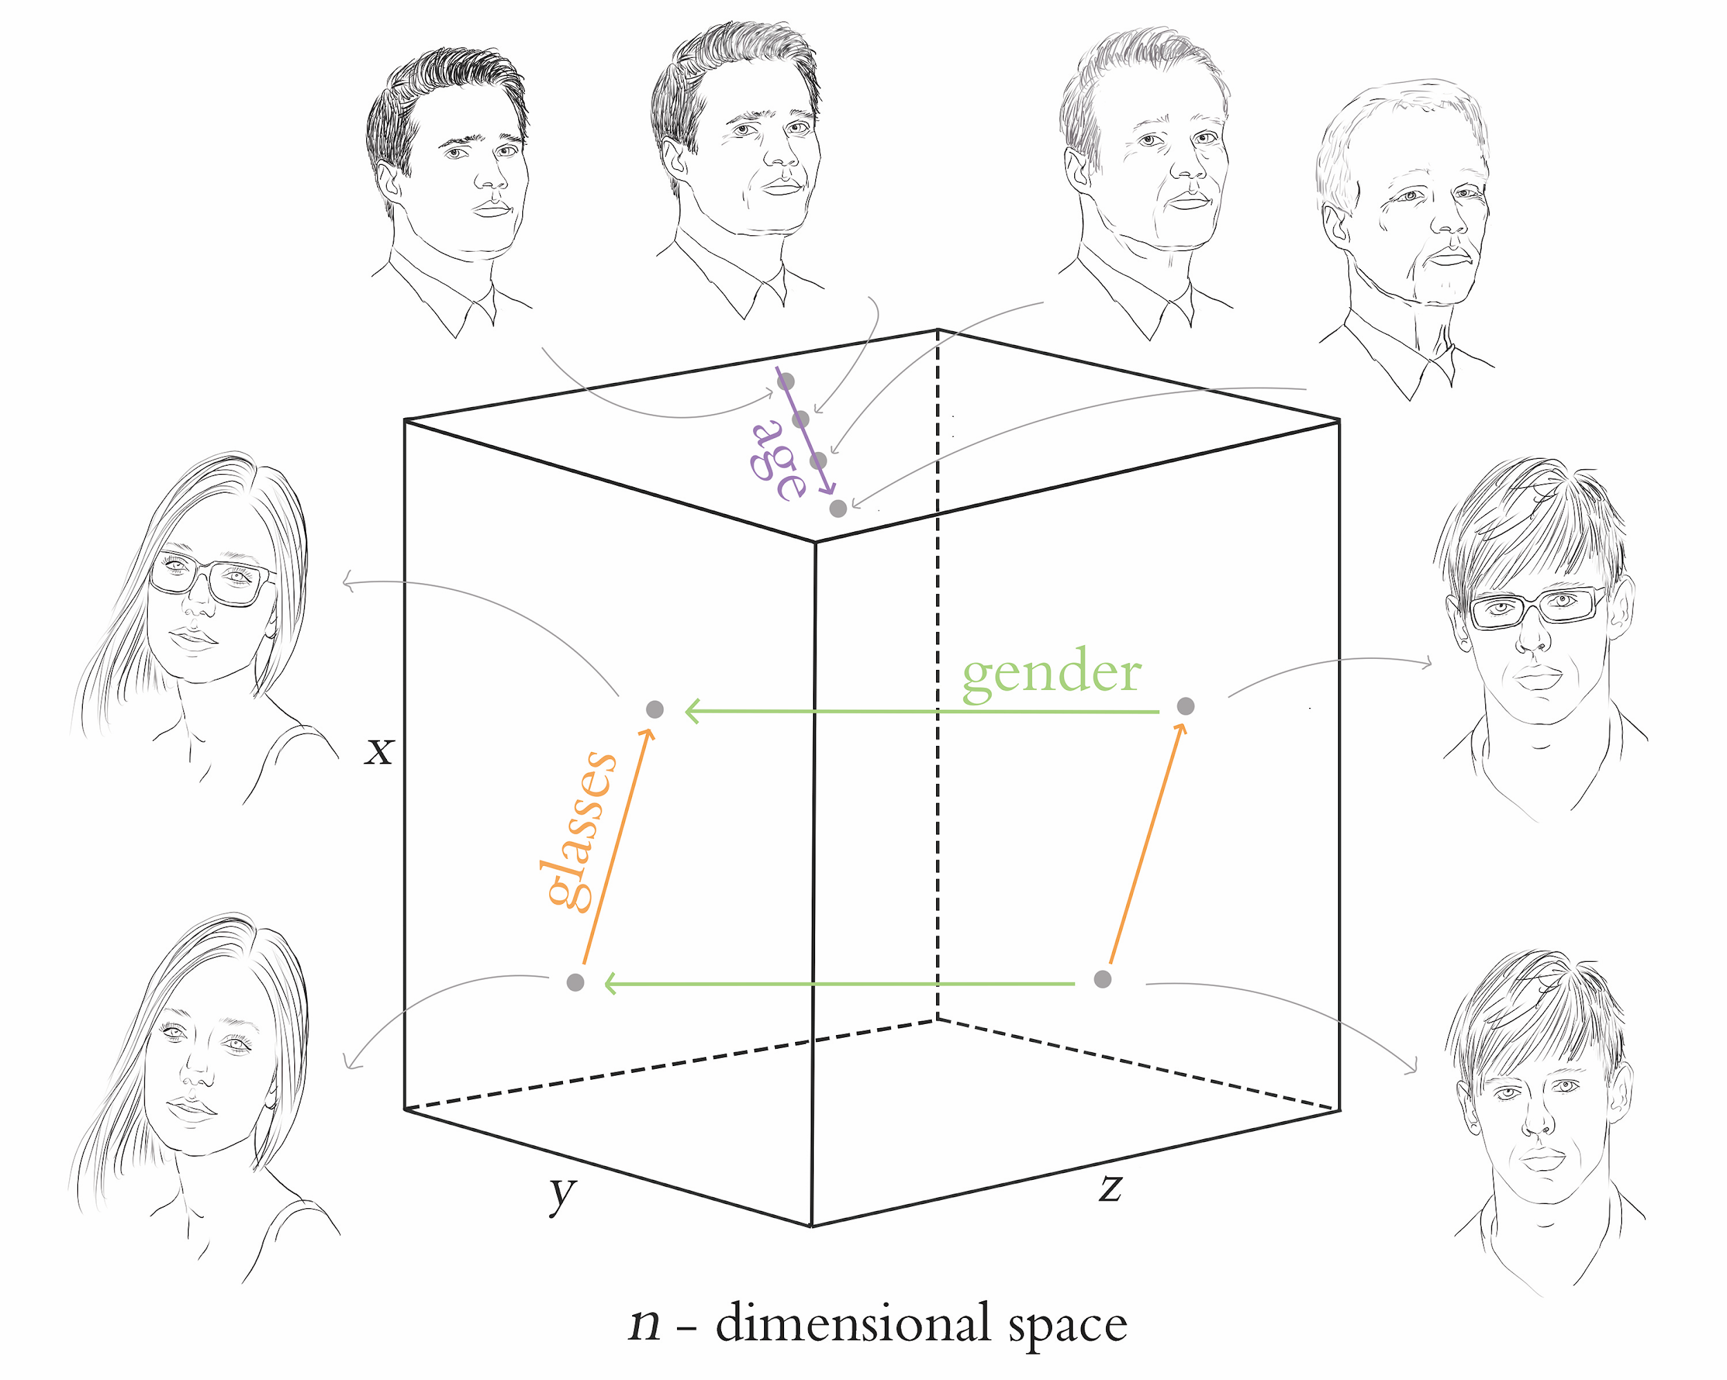

Slide 7
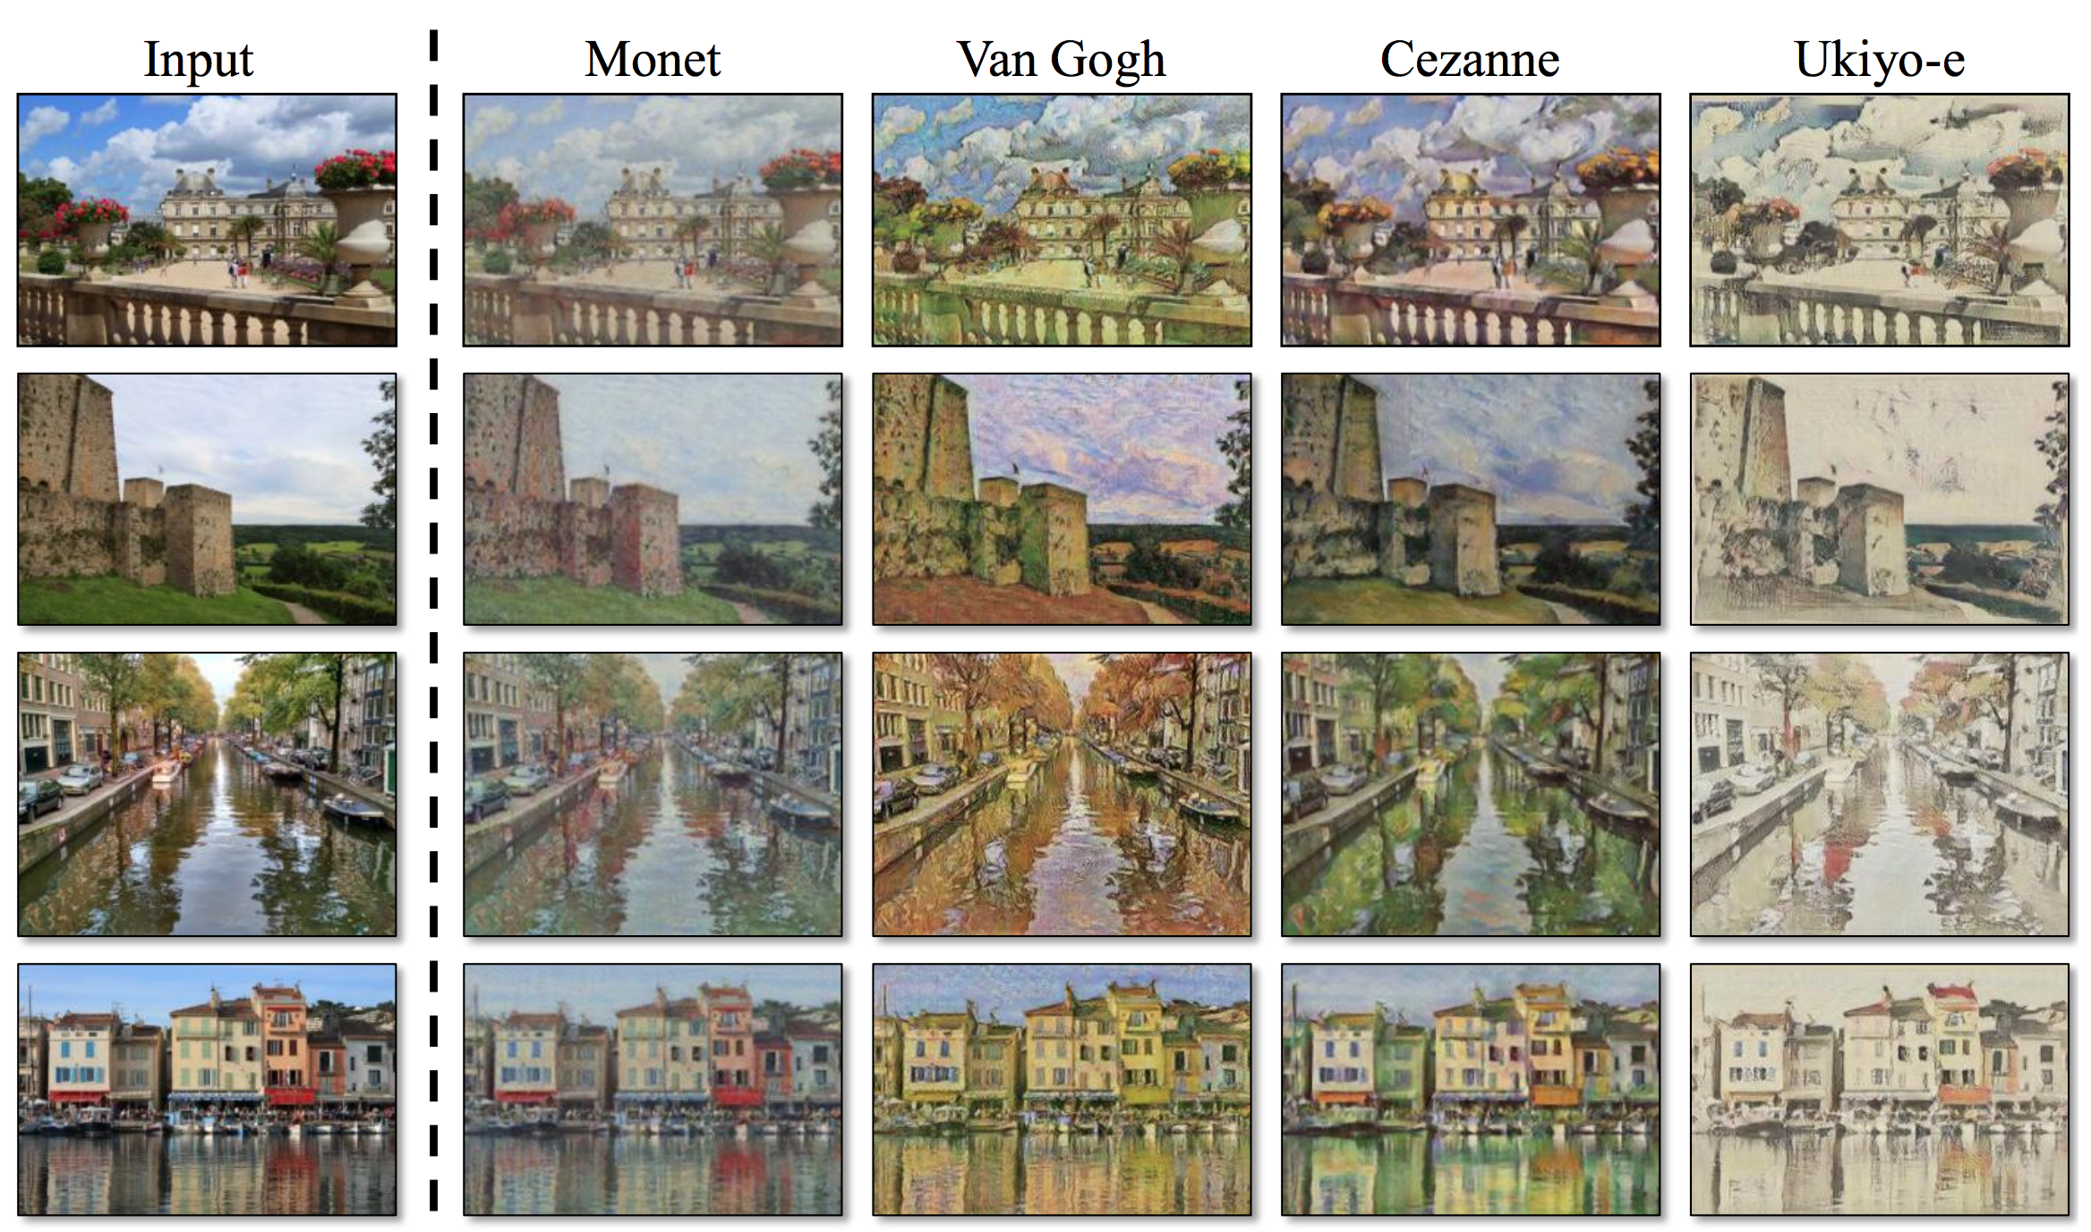
CycleGAN (Zhu et al., 2017)
bit.ly/cycleGAN
arXiv: 1703.10593

Slide 8
Applications of GANs
Make $400,000 generating “art”
Increase the resolution of an image
Simulate data, e.g., for training autonomous vehicles
Predict next frames of video
Speed fashion/architectural design (sketches to photorealism)
Edit images with realistic, nuanced changes
Artificial Intelligence Augmentation (distill.pub/2017/aia)
Can also generate time series like text, prices, audio

Slide 9
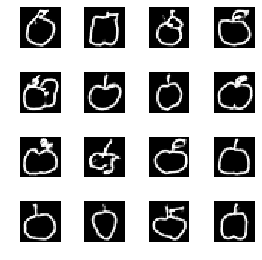

Slide 10
Chapter 12

Slide 12
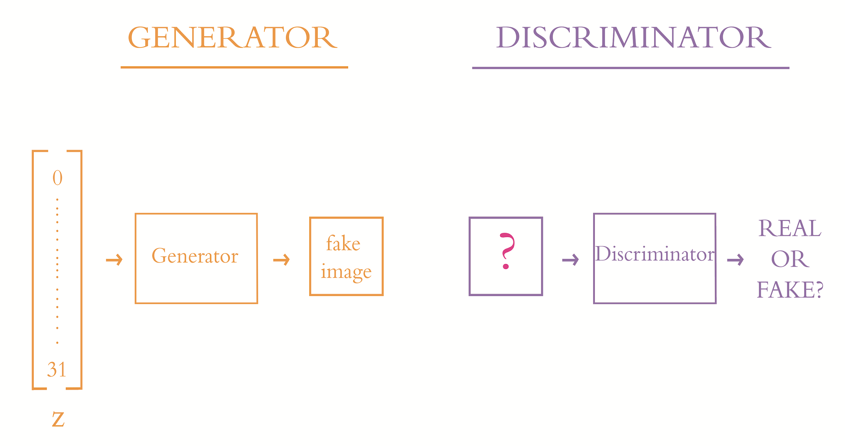

Slide 13
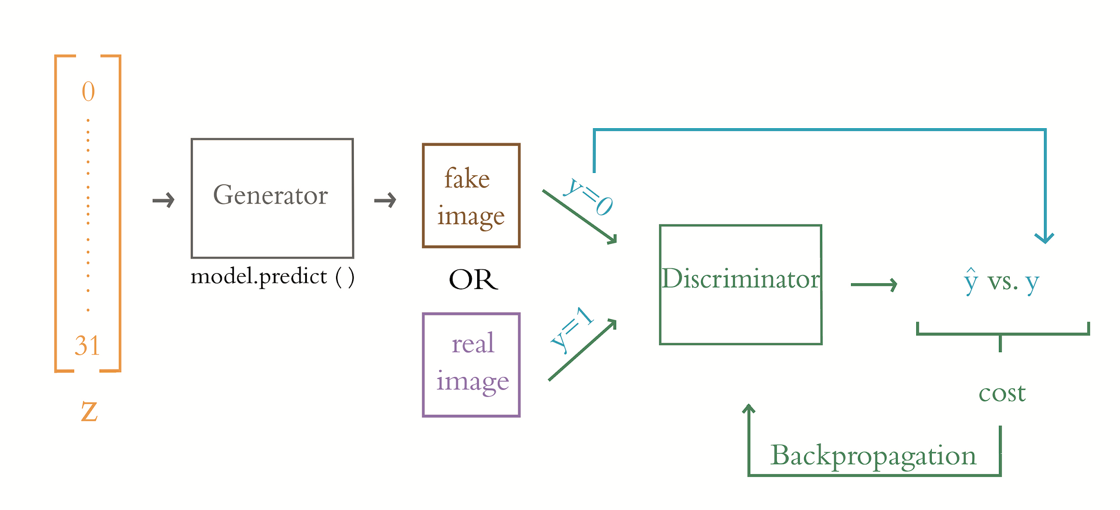
Training the Discriminator

Slide 14
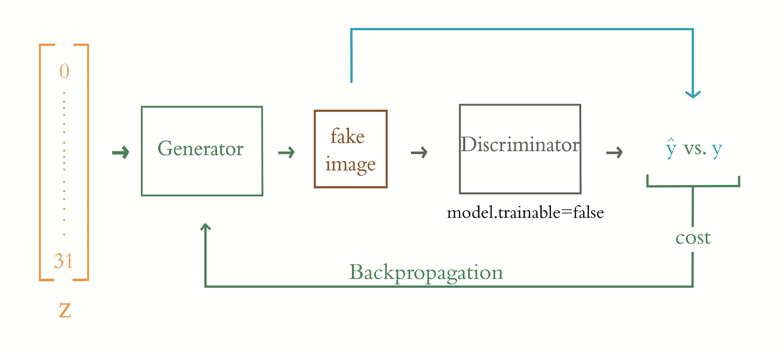
Training the Generator

Slide 16
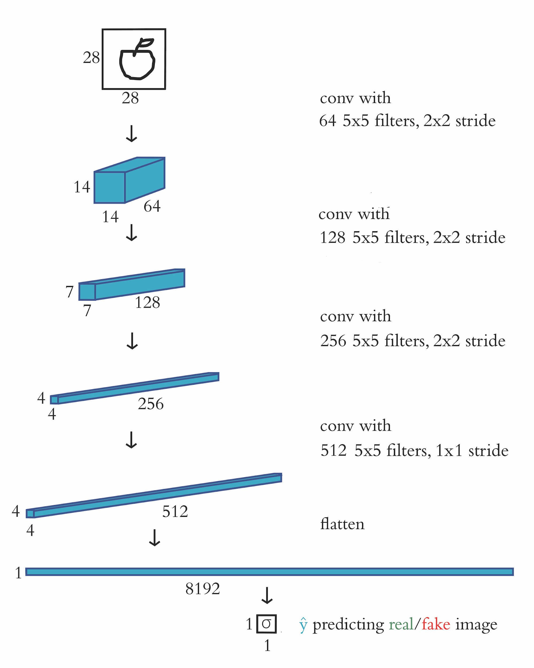

Slide 17
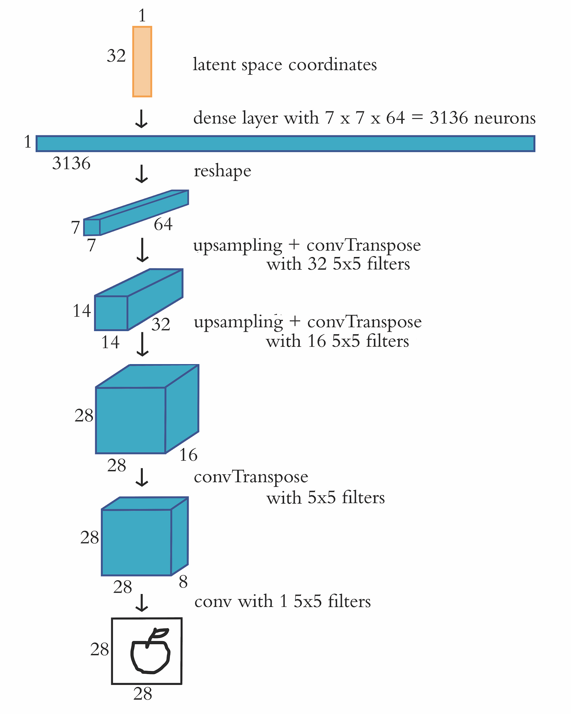

Slide 18
Training the Discriminator

Slide 19
Training the Generator

Slide 20
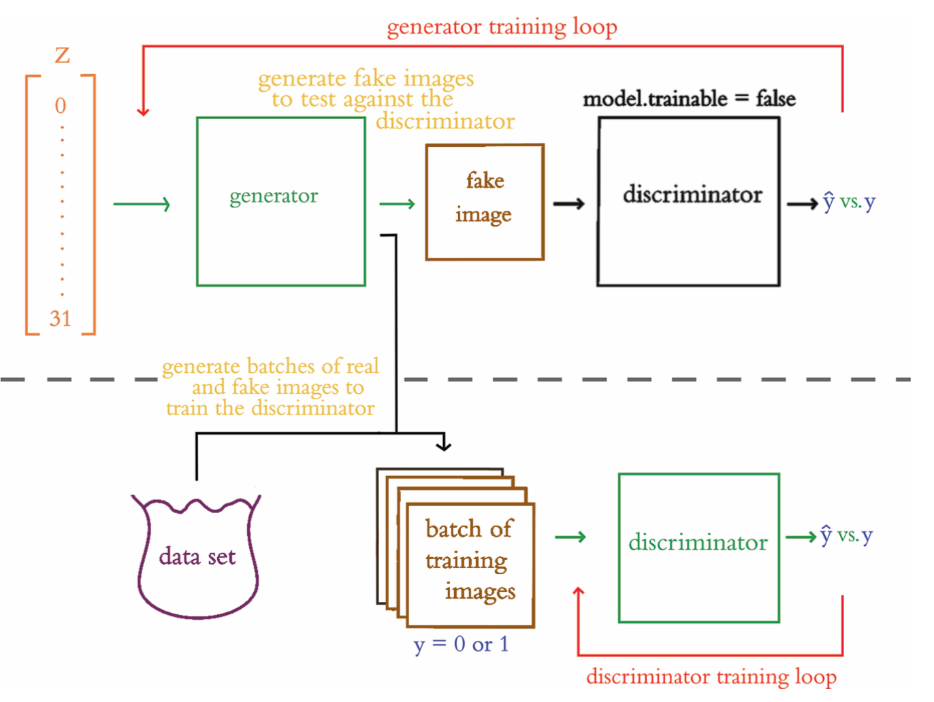

Slide 21
Chapter 4

Slide 22
Artificial Intelligence

Slide 23
Three Categories of AI
ANI: Artificial Narrow Intelligence
AGI: Artificial General Intelligence
ASI: Artificial Super Intelligence

Slide 24
Artificial Intelligence

Slide 25
Artificial Intelligence
Machine Learning

Slide 26
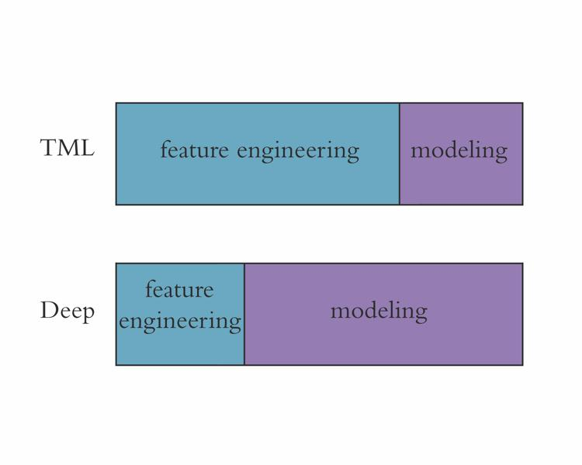

Slide 27
Artificial Intelligence
Machine Learning
Representation Learning

Slide 28
Artificial Intelligence
Machine Learning
Representation Learning
Artificial Neural Networks

Slide 29
Artificial Intelligence
Machine Learning
Representation Learning
Artificial Neural Networks

Slide 30
Artificial Intelligence
Machine Learning
Representation Learning
ANNs / Deep Learning

Slide 31
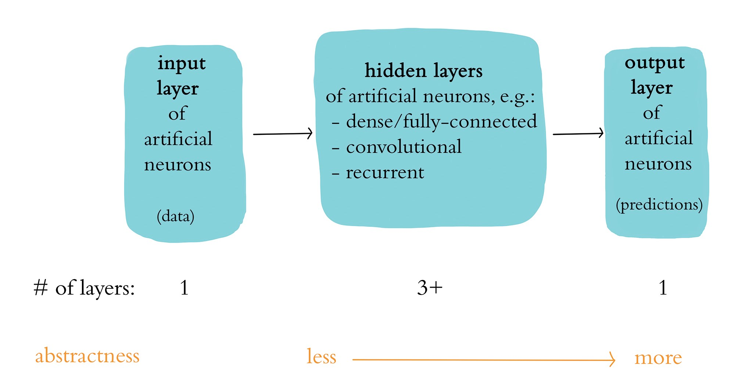
A Generalized Deep Learning Model

Slide 32
Artificial Intelligence
Machine Learning
Representation Learning
ANNs / Deep Learning

Slide 33
Artificial Intelligence
Machine Learning
Representation Learning
ANNs / Deep Learning
Machine
Vision

Slide 34
Artificial Intelligence
Machine Learning
Representation Learning
ANNs / Deep Learning
Machine
Vision
CNNs

Slide 35
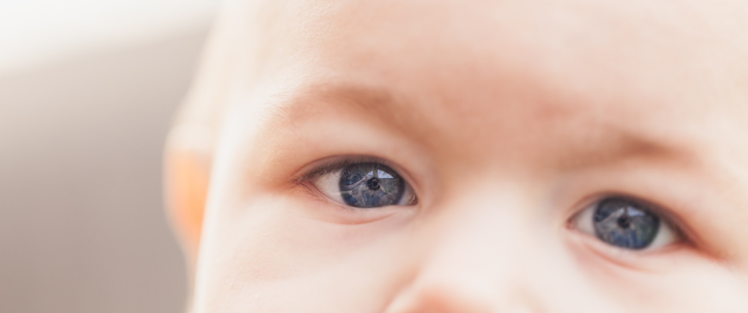
ConvNets: Convolutional Networks
unsplash.com/photos/b8p8nqFshyY

Slide 36
Artificial Intelligence
Machine Learning
Representation Learning
ANNs / Deep Learning
Machine
Vision
CNNs

Slide 37
Artificial Intelligence
Machine Learning
Representation Learning
ANNs / Deep Learning
Machine
Vision
CNNs
GANs

Slide 38

GANs: Generative Adversarial Networks NetwprlsNetwor
unsplash.com/photos/FwF_fKj5tBo

Slide 39
Artificial Intelligence
Machine Learning
Representation Learning
ANNs / Deep Learning
DL for
NLP
NLP
Machine
Vision
CNNs
GANs

Slide 40
Artificial Intelligence
Machine Learning
Representation Learning
ANNs / Deep Learning
DL for
NLP
RNNs
NLP
Machine
Vision
CNNs
GANs

Slide 41
Artificial Intelligence
Machine Learning
Representation Learning
ANNs / Deep Learning
DL for
NLP
RNNs
NLP
LSTMs
Machine
Vision
CNNs
GANs

Slide 42

RNNs: Recurrent Neural Networks
unsplash.com/photos/cZhUxIQjILg

Slide 43
Artificial Intelligence
Machine Learning
Representation Learning
ANNs / Deep Learning
DL for
NLP
RNNs
NLP
LSTMs
Machine
Vision
CNNs
GANs

Slide 44
Artificial Intelligence
Machine Learning
Representation Learning
ANNs / Deep Learning
DL for
NLP
RNNs
NLP
LSTMs
Machine
Vision
CNNs
GANs
Reinforcement
Learning

Slide 45
Categories of Machine Learning Problems
Supervised Learning
Unsupervised Learning
Reinforcement Learning

Slide 46
Supervised Learning
Have x and y
Goal: learn function that uses x to approximate y
Examples:
classification
handwritten digits
movie-review sentiment
regression
sales of a product
future value of an asset (e.g., a home)

Slide 47
Unsupervised Learning
Have x only -- no y labels available
Goal: learn hidden, underlying structure of data x
Examples:
clustering by topic
word vectors
GANs

Slide 48
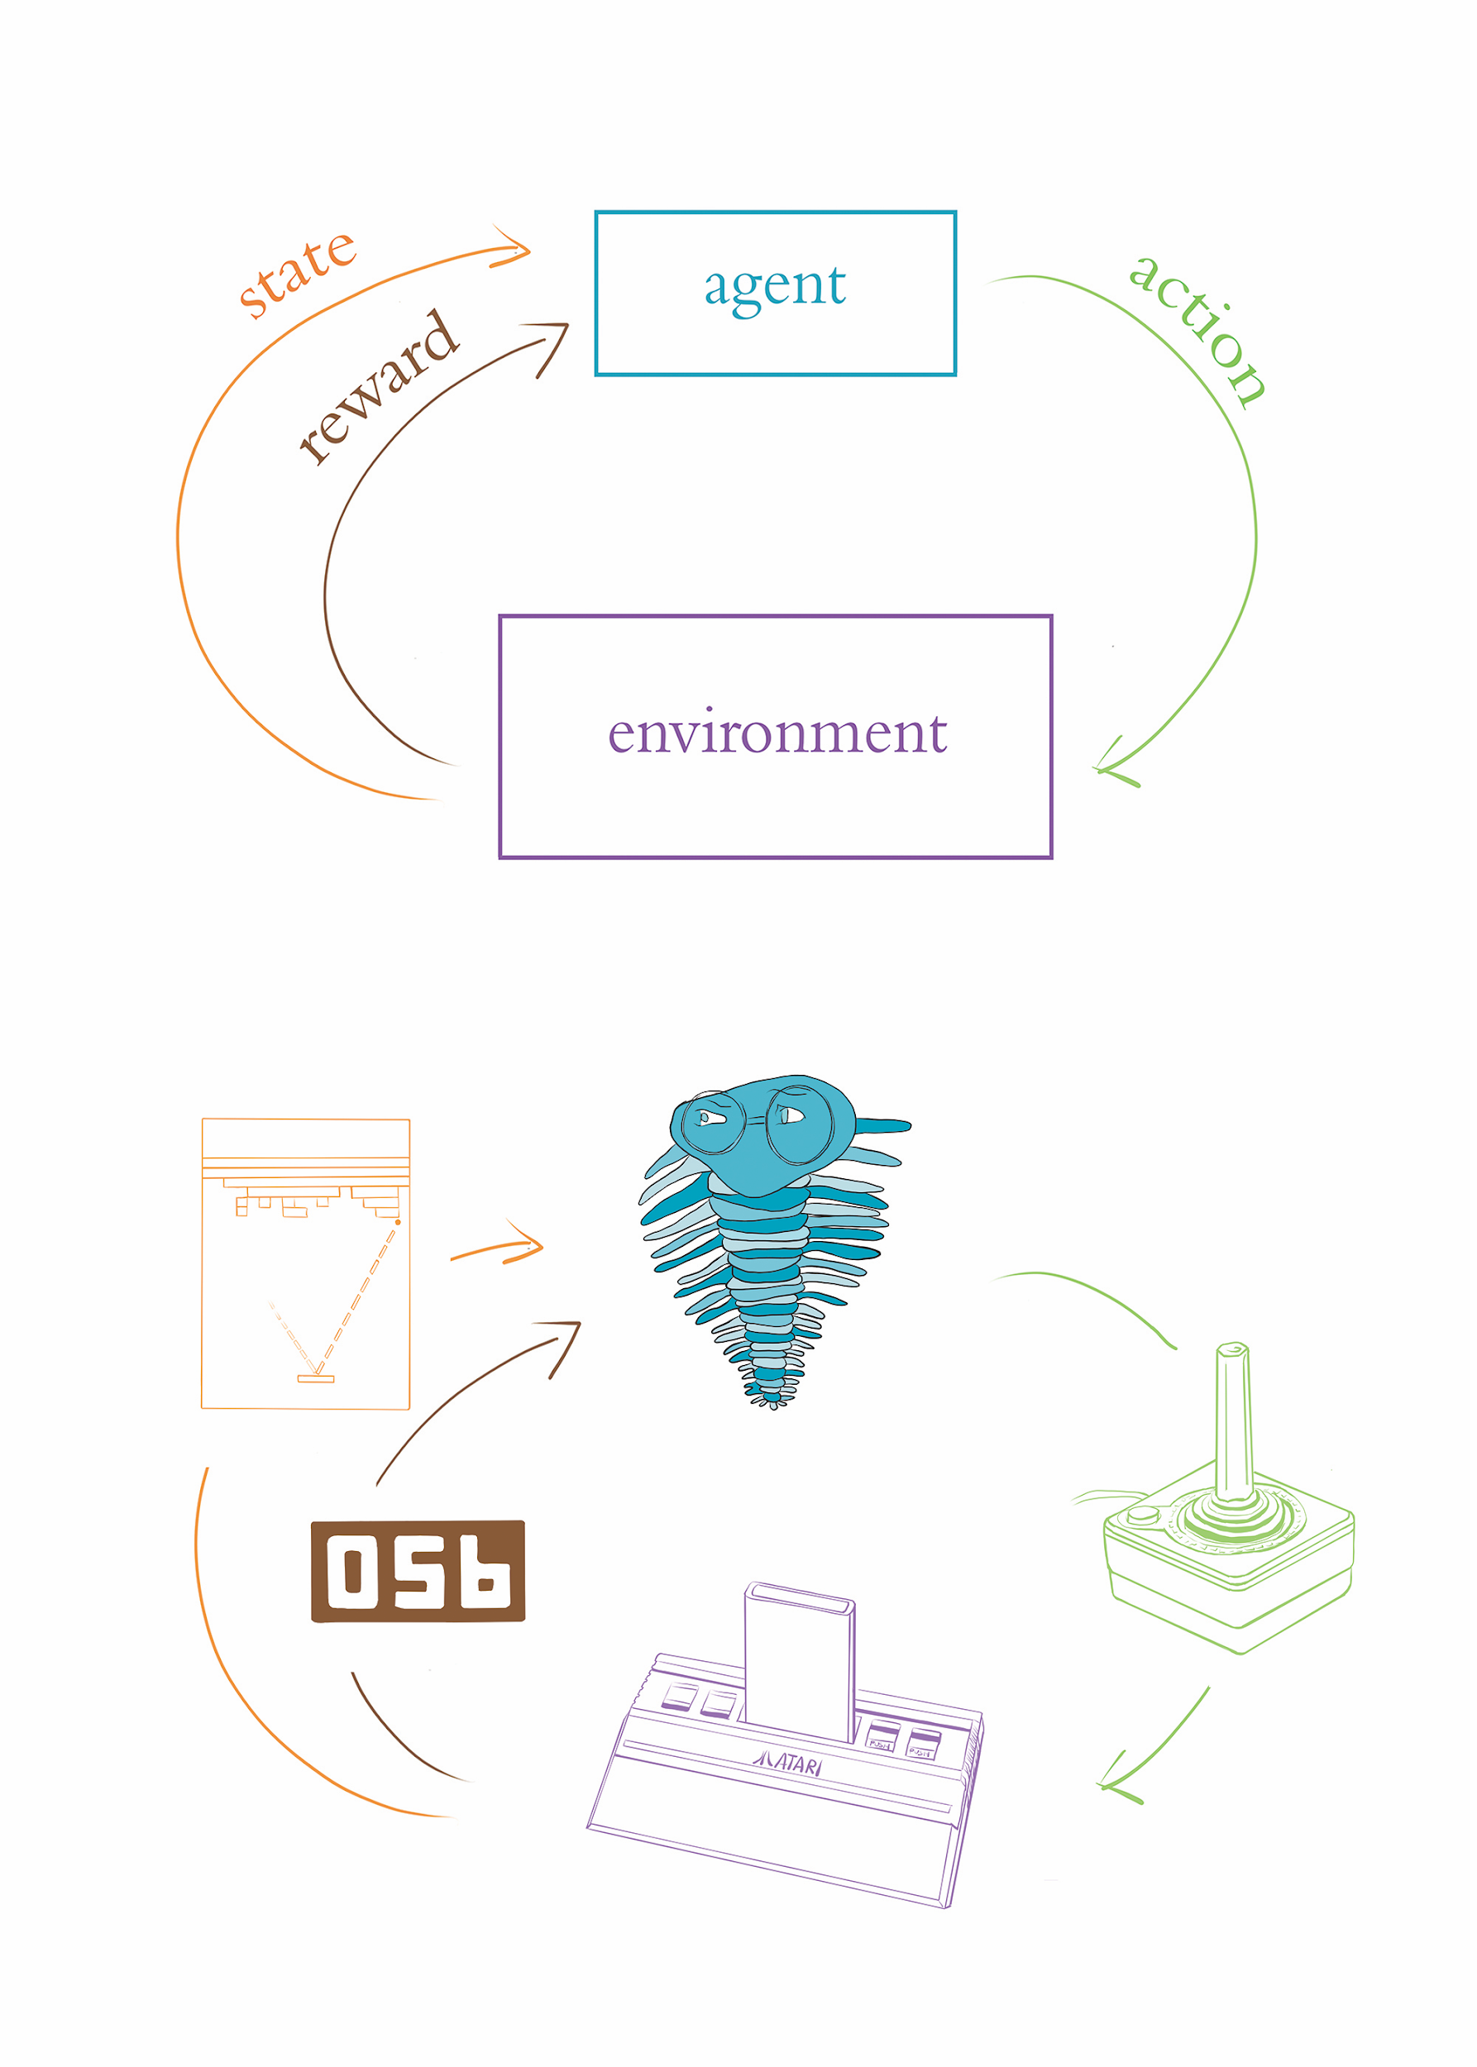
Reinforcement Learning

Slide 49
Reinforcement Learning

Slide 50
Artificial Intelligence
Machine Learning
Representation Learning
ANNs / Deep Learning
DL for
NLP
RNNs
NLP
LSTMs
Machine
Vision
CNNs
GANs
Reinforcement
Learning

Slide 51
Artificial Intelligence
Machine Learning
Representation Learning
ANNs / Deep Learning
DL for
NLP
RNNs
NLP
LSTMs
Machine
Vision
CNNs
Deep
RL
GANs
Reinforcement
Learning

Slide 52
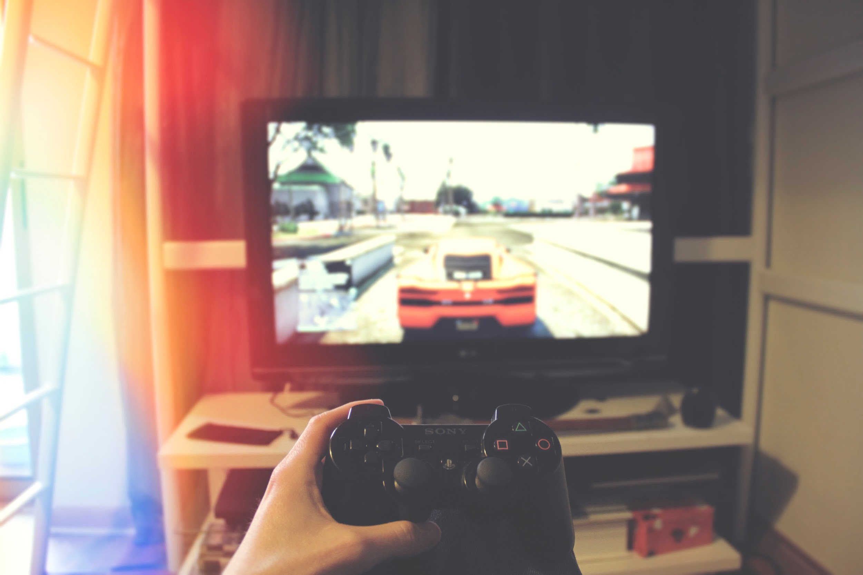
Deep Reinforcement Learning
unsplash.com/photos/pxnDAT77rVg

Slide 53
Factors Behind the Deep Learning Tsunami
Data
Compute
Theoretical Advances

Slide 54
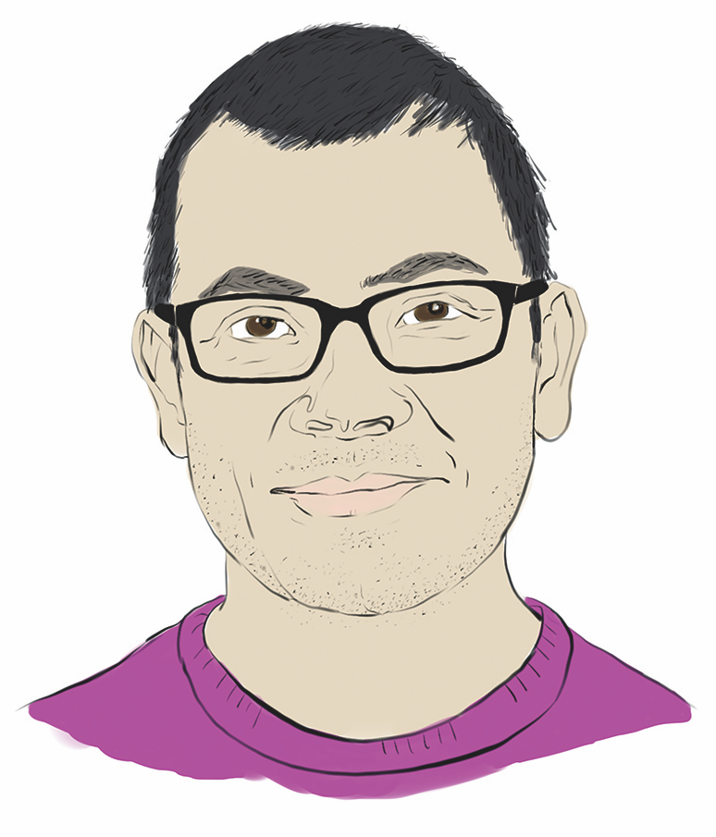
DeepMind’s Demis Hassabis

Slide 55
“Playing Atari with Deep RL”
Mnih et al. (2013)
NIPS and arXiv paper
“Deep Q-Learning” algorithm
played seven Atari 2600 games
beat previous ML approaches on six
beat human expert on three

Slide 56
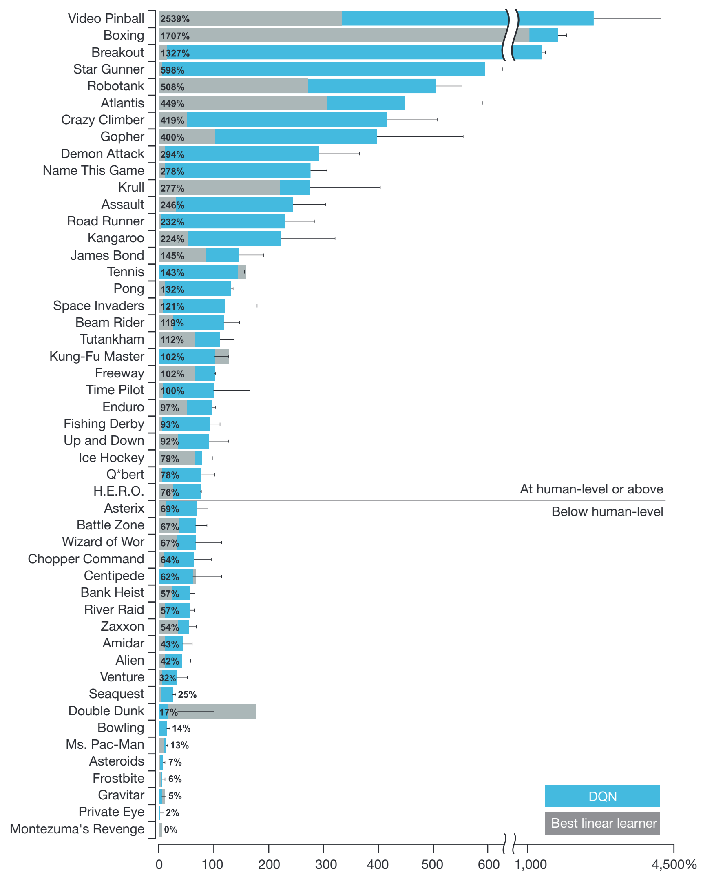
Mnih et al. (2015)
Nature 518: 529-33

Slide 57
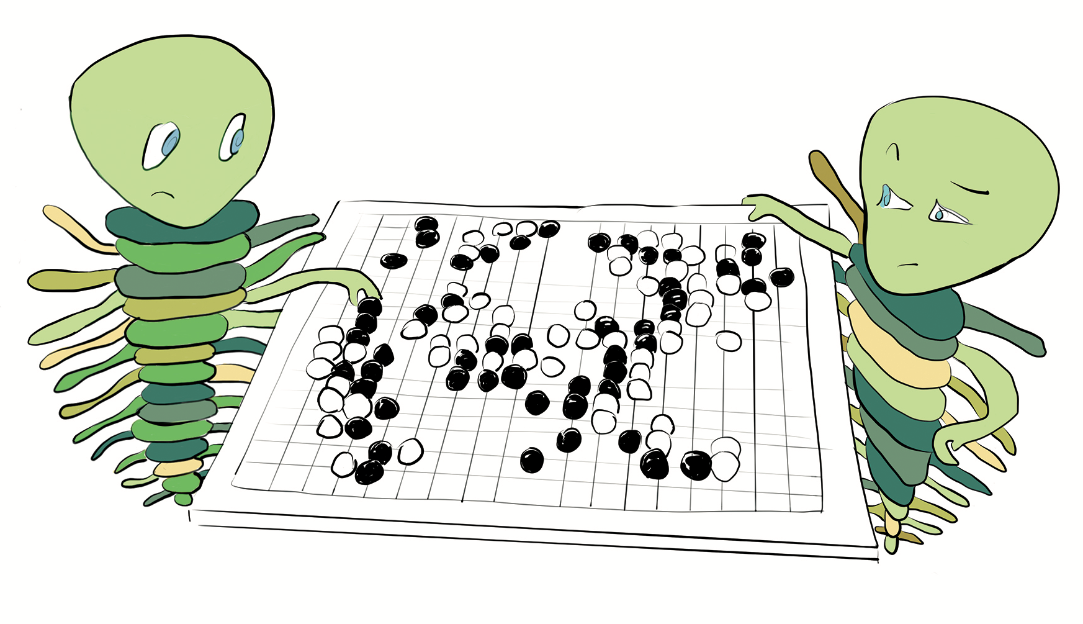
The Board Game “Go”

Slide 58
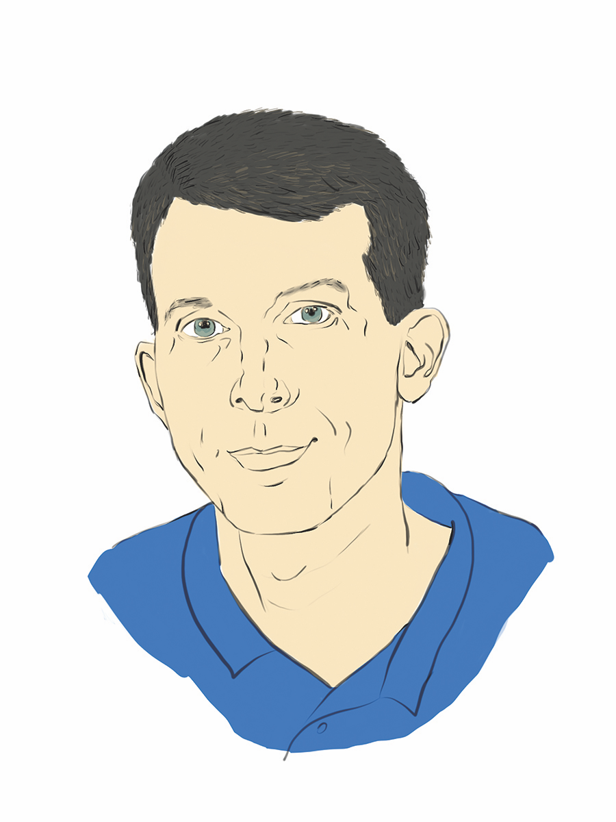
AlphaGo (Silver et al., 2016)

Slide 59
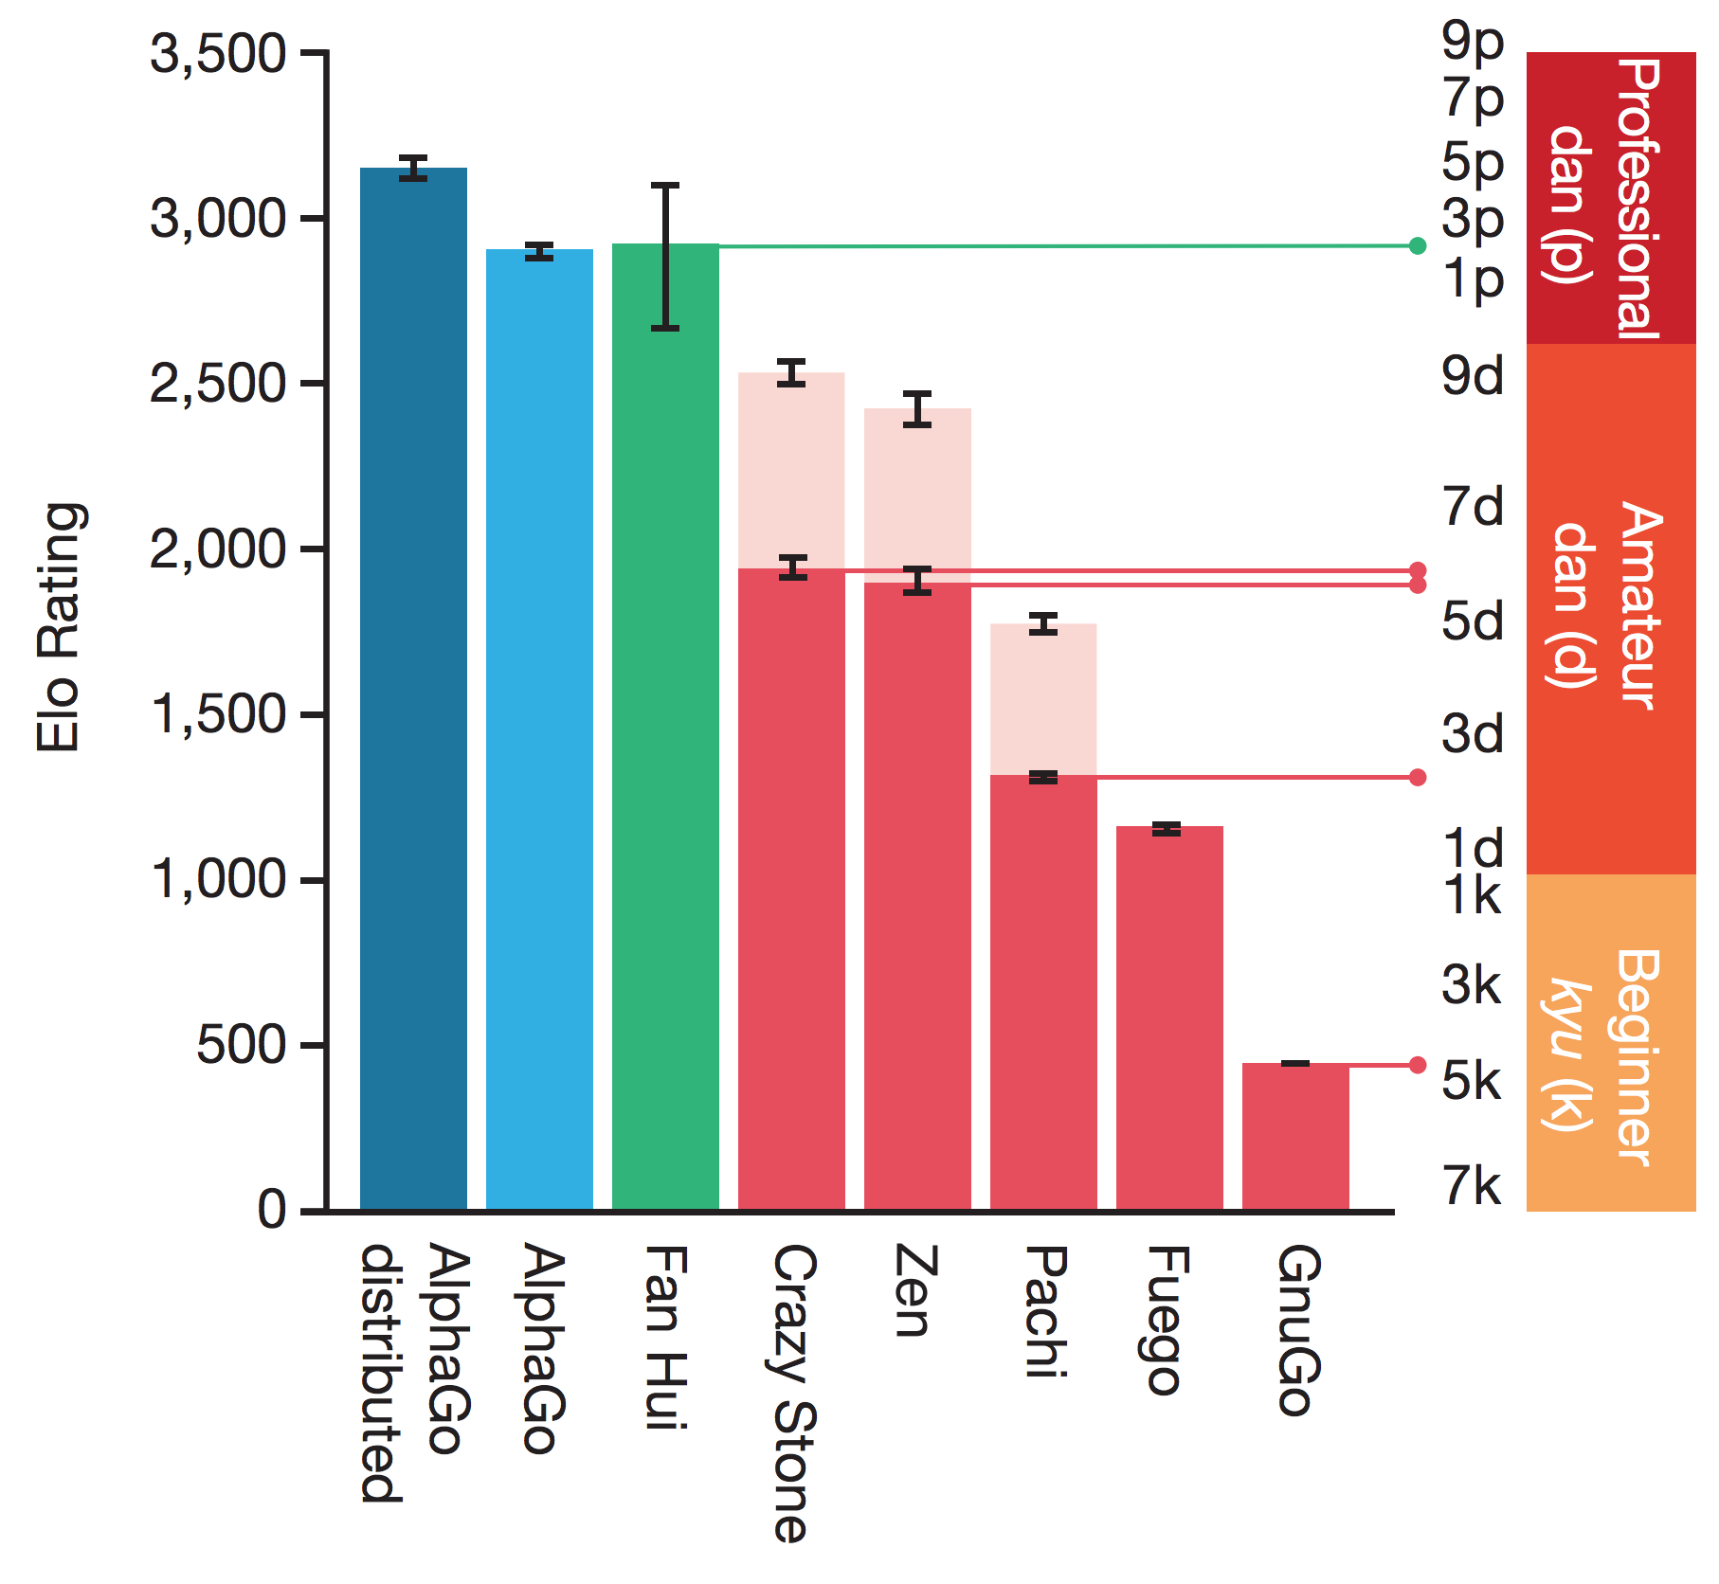
AlphaGo (Silver et al., 2016)
Nature 529: 484-9

Slide 60
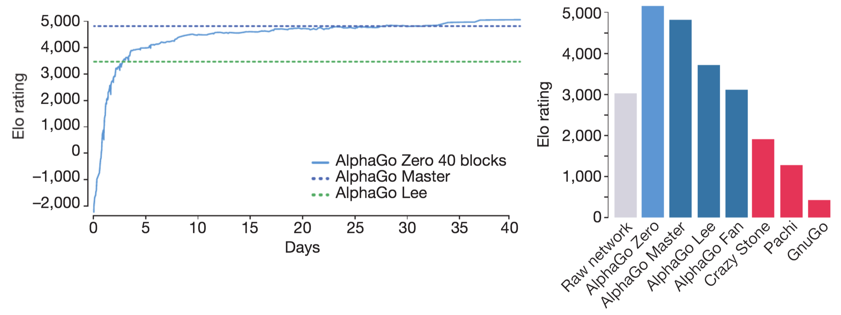
AlphaGo Zero (Silver et al., 2017a)
Nature 550: 354-9

Slide 61
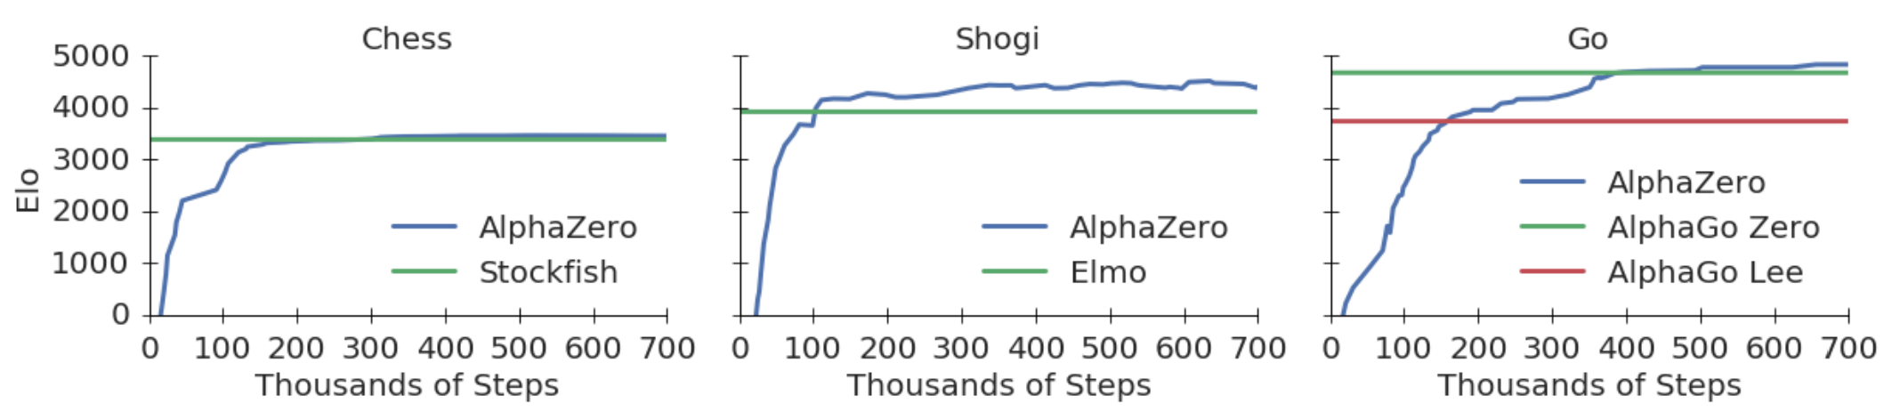
AlphaZero (Silver et al., 2017b)
arXiv: 1712.01815

Slide 62
Real-World Applications of Deep RL
Saving energy
AlphaFold
Any problem defined as RL problem, e.g.:
Keeping warehouse stocked
Maximizing profits with trading strategy
Robotics

Slide 63
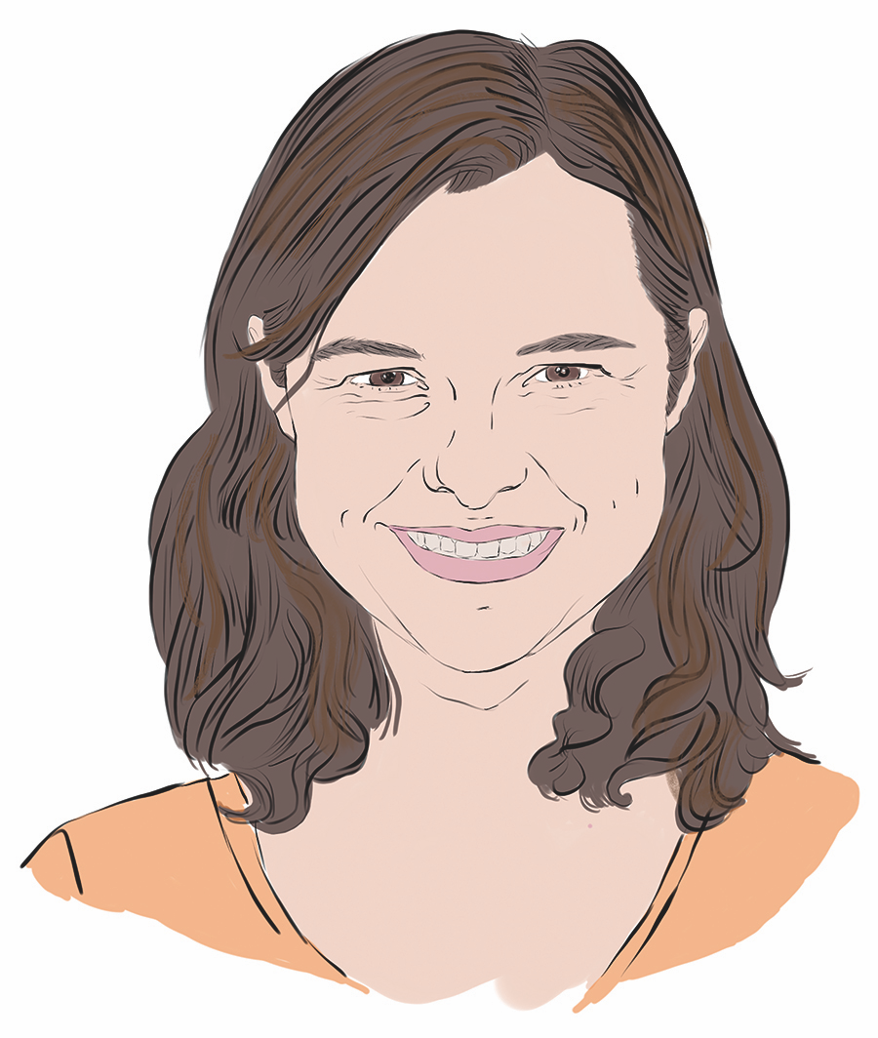
Levine, Finn, et al. (2016)

Slide 64
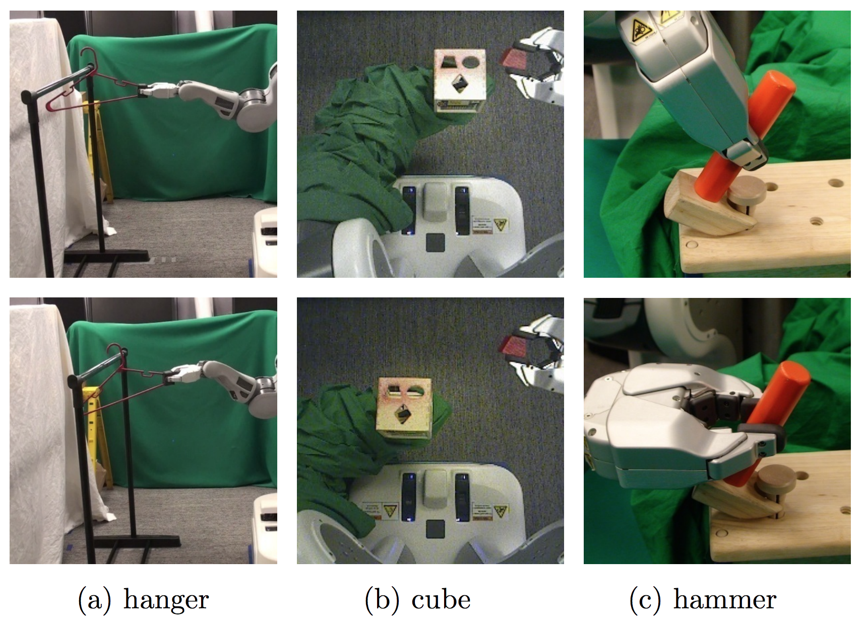
Levine, Finn, et al. (2016)
Journal of Machine Learning Research 17: 1-40

Slide 65
Popular Deep RL Environments
OpenAI Gym: github.com/openai/gym
DeepMind Lab: github.com/deepmind/lab
Unity: github.com/Unity-Technologies/ml-agents
...or create your own with PyGame Learning Environment

Slide 66
Categories of Artificial Intelligence
ANI: Narrow
AGI: General
ASI: Super

Slide 67
Chapter 13

Slide 68

The Cart-Pole Game

Slide 69
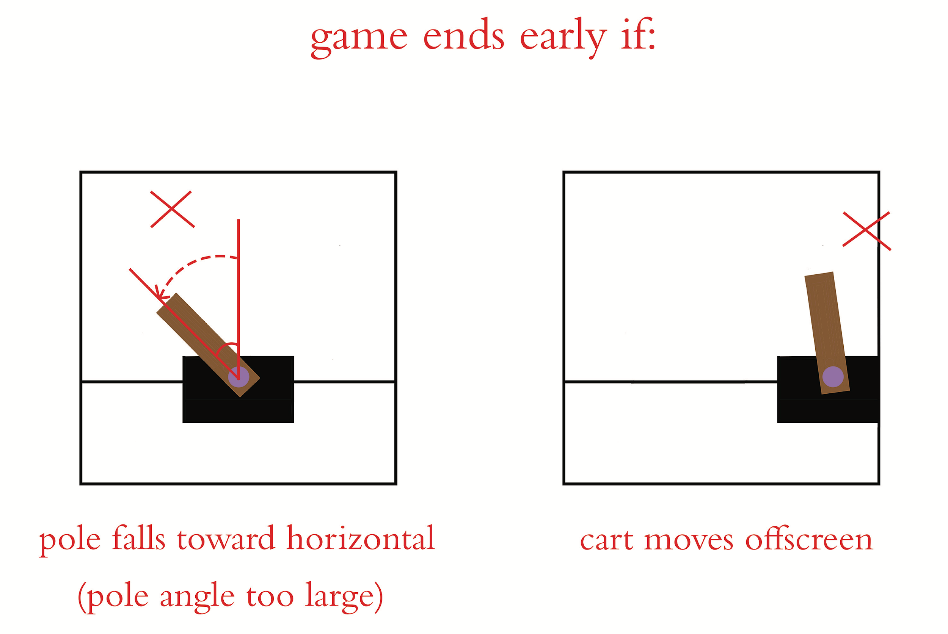
The Cart-Pole Game

Slide 70
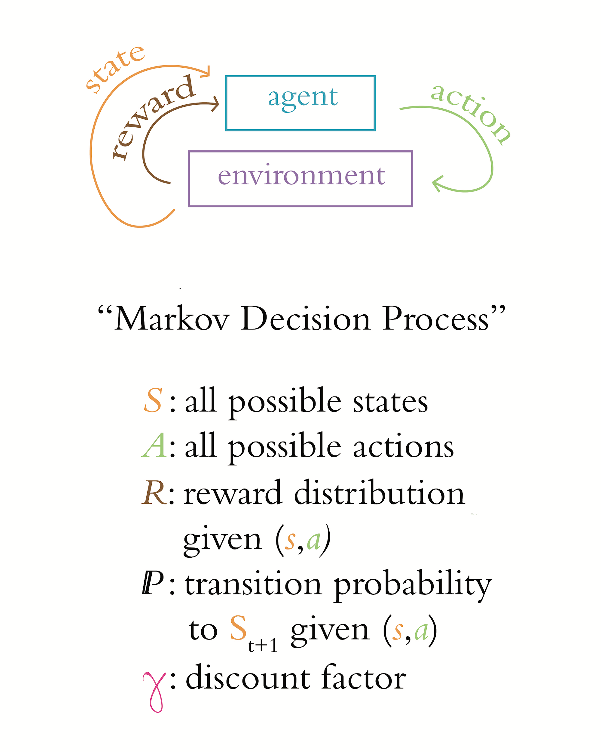
The Reinforcement Learning Loop

Slide 71
The Cart-Pole Game
Environment States:
Cart Position
Cart Velocity
Pole Angle
Pole Angular Velocity
Actions:
Move Cart Left
Move Cart Right

Slide 72
Markov Decision Process

Slide 73
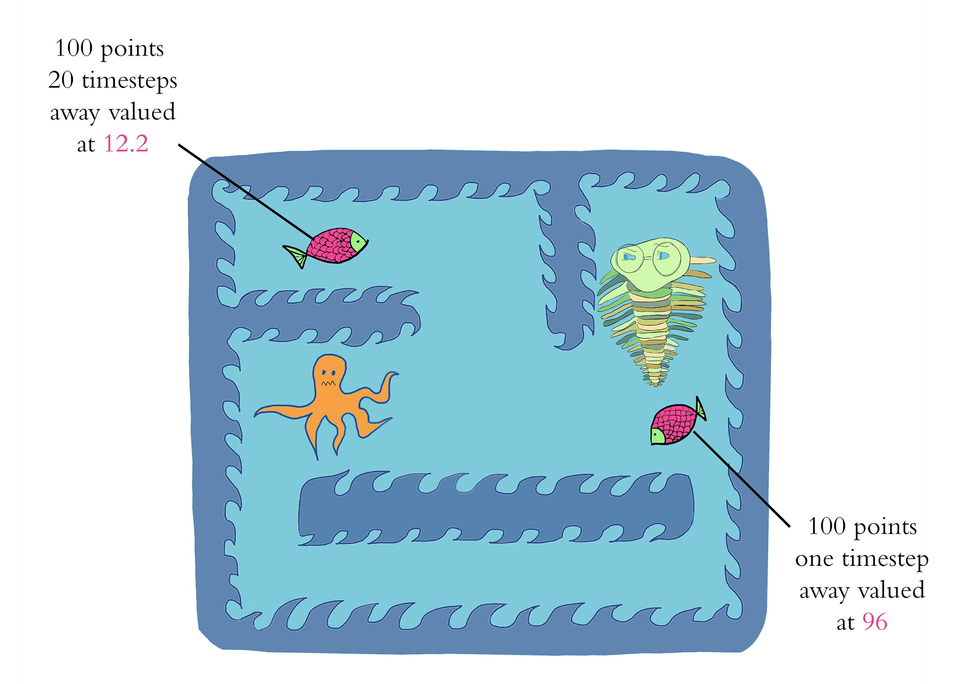
Discount Factor gamma

Slide 74
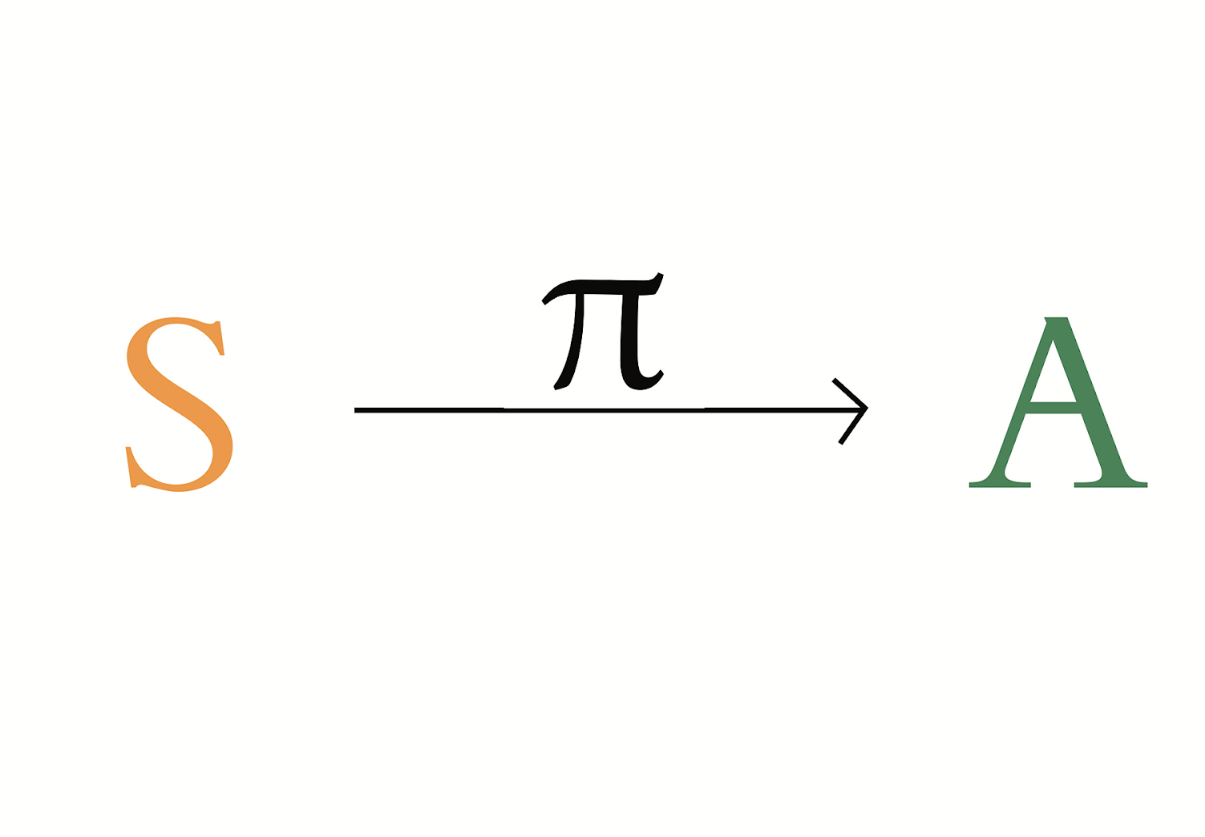
The Optimal Policy

Slide 76
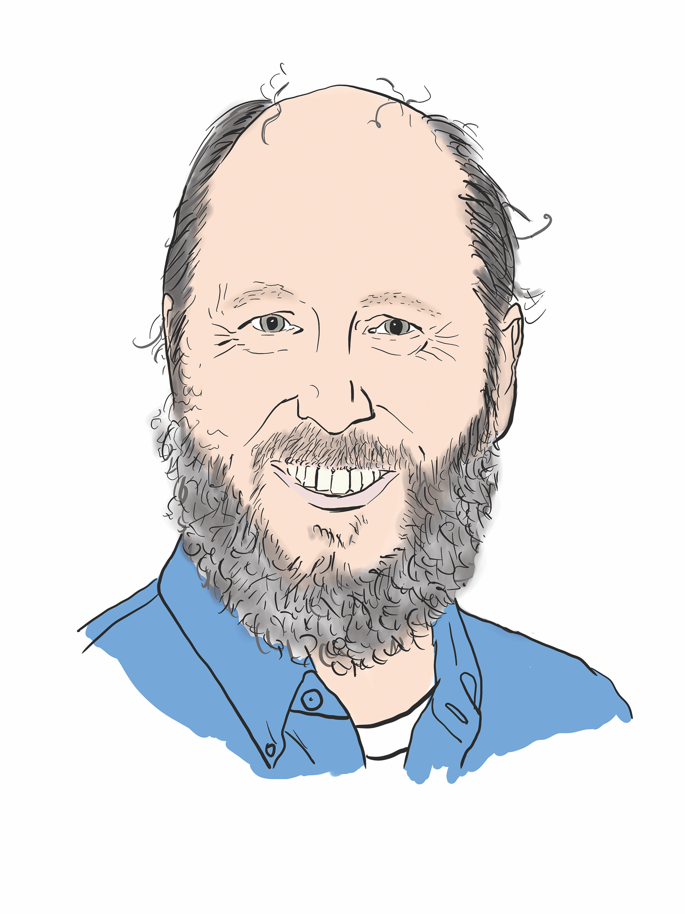
Richard Sutton

Slide 77
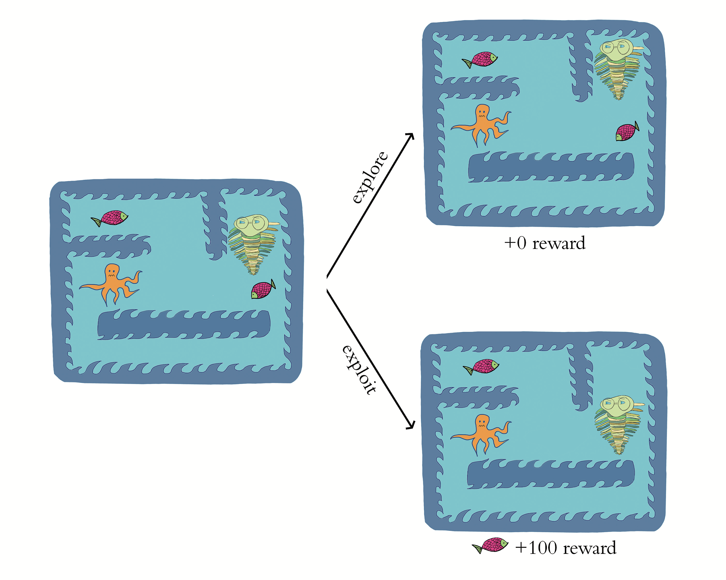
Exploration Rate epsilon

Slide 78
SLM Lab Features
Ready-Made Deep RL Agents
Modular Agent Components
Various Environment Libraries
Multiple Environment Libraries Simultaneously
Performance Benchmarking
Hyperparameter Tuning

Slide 79
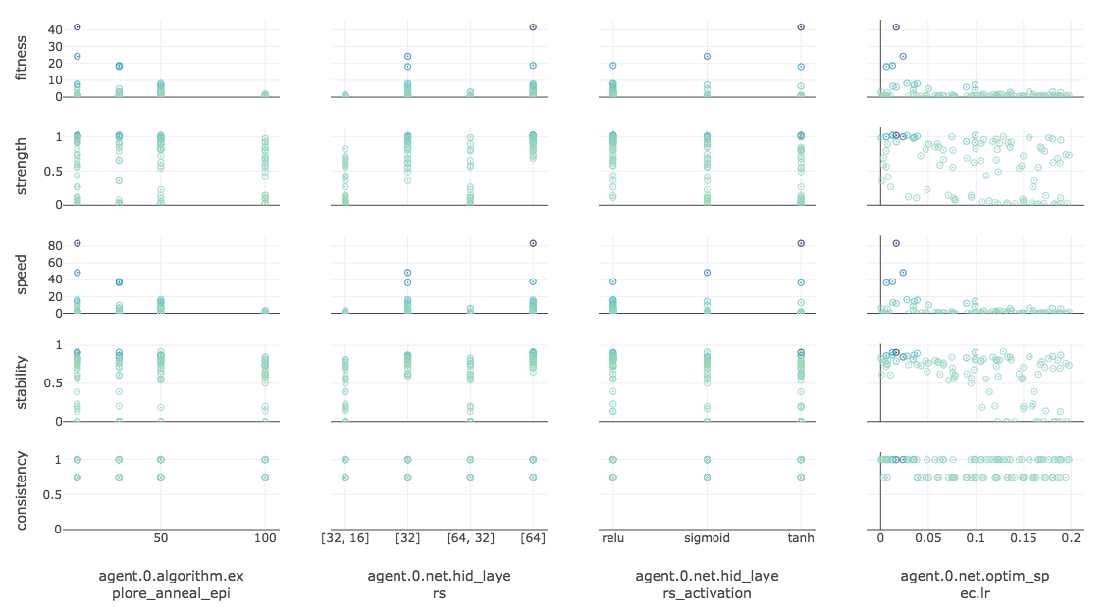

Slide 80
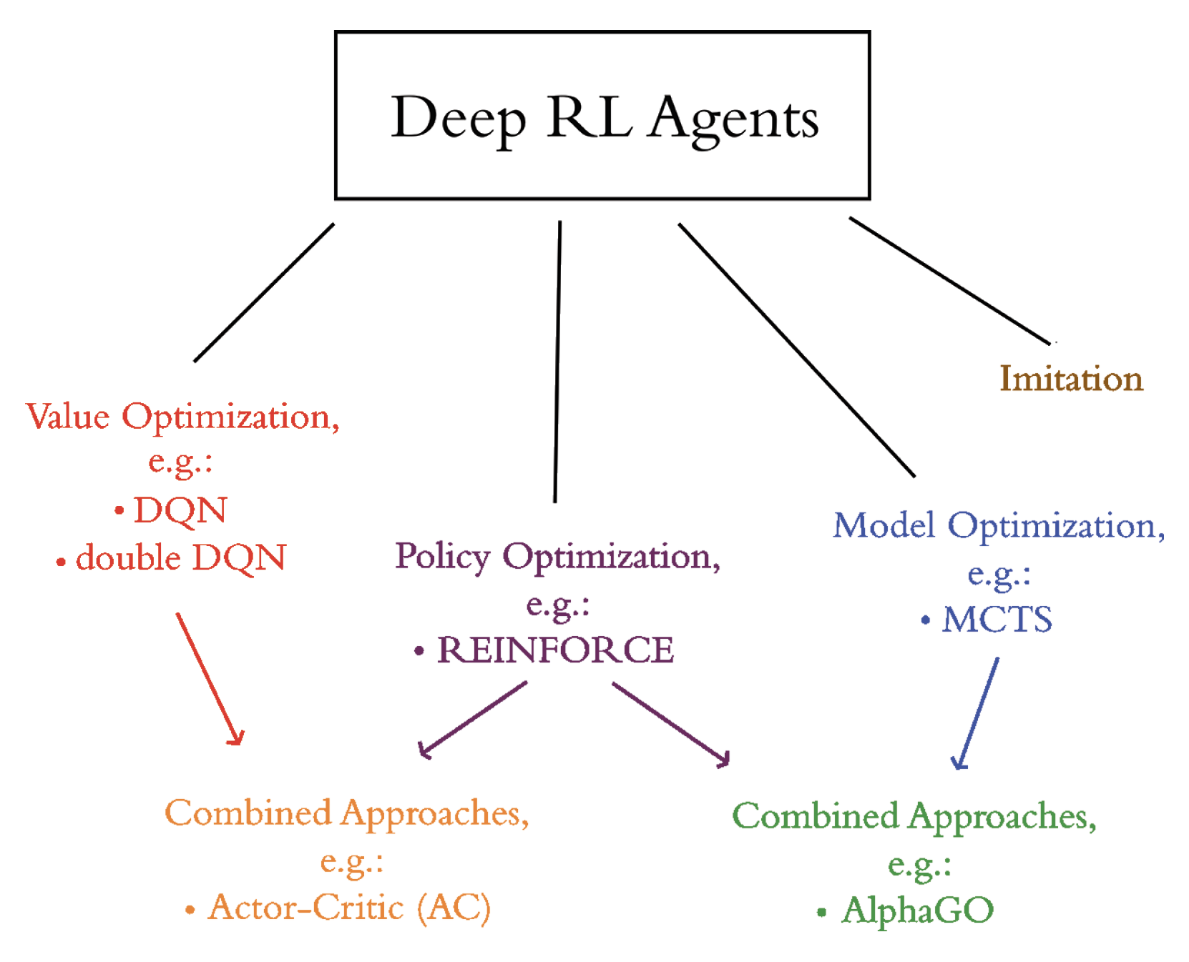

Slide 81
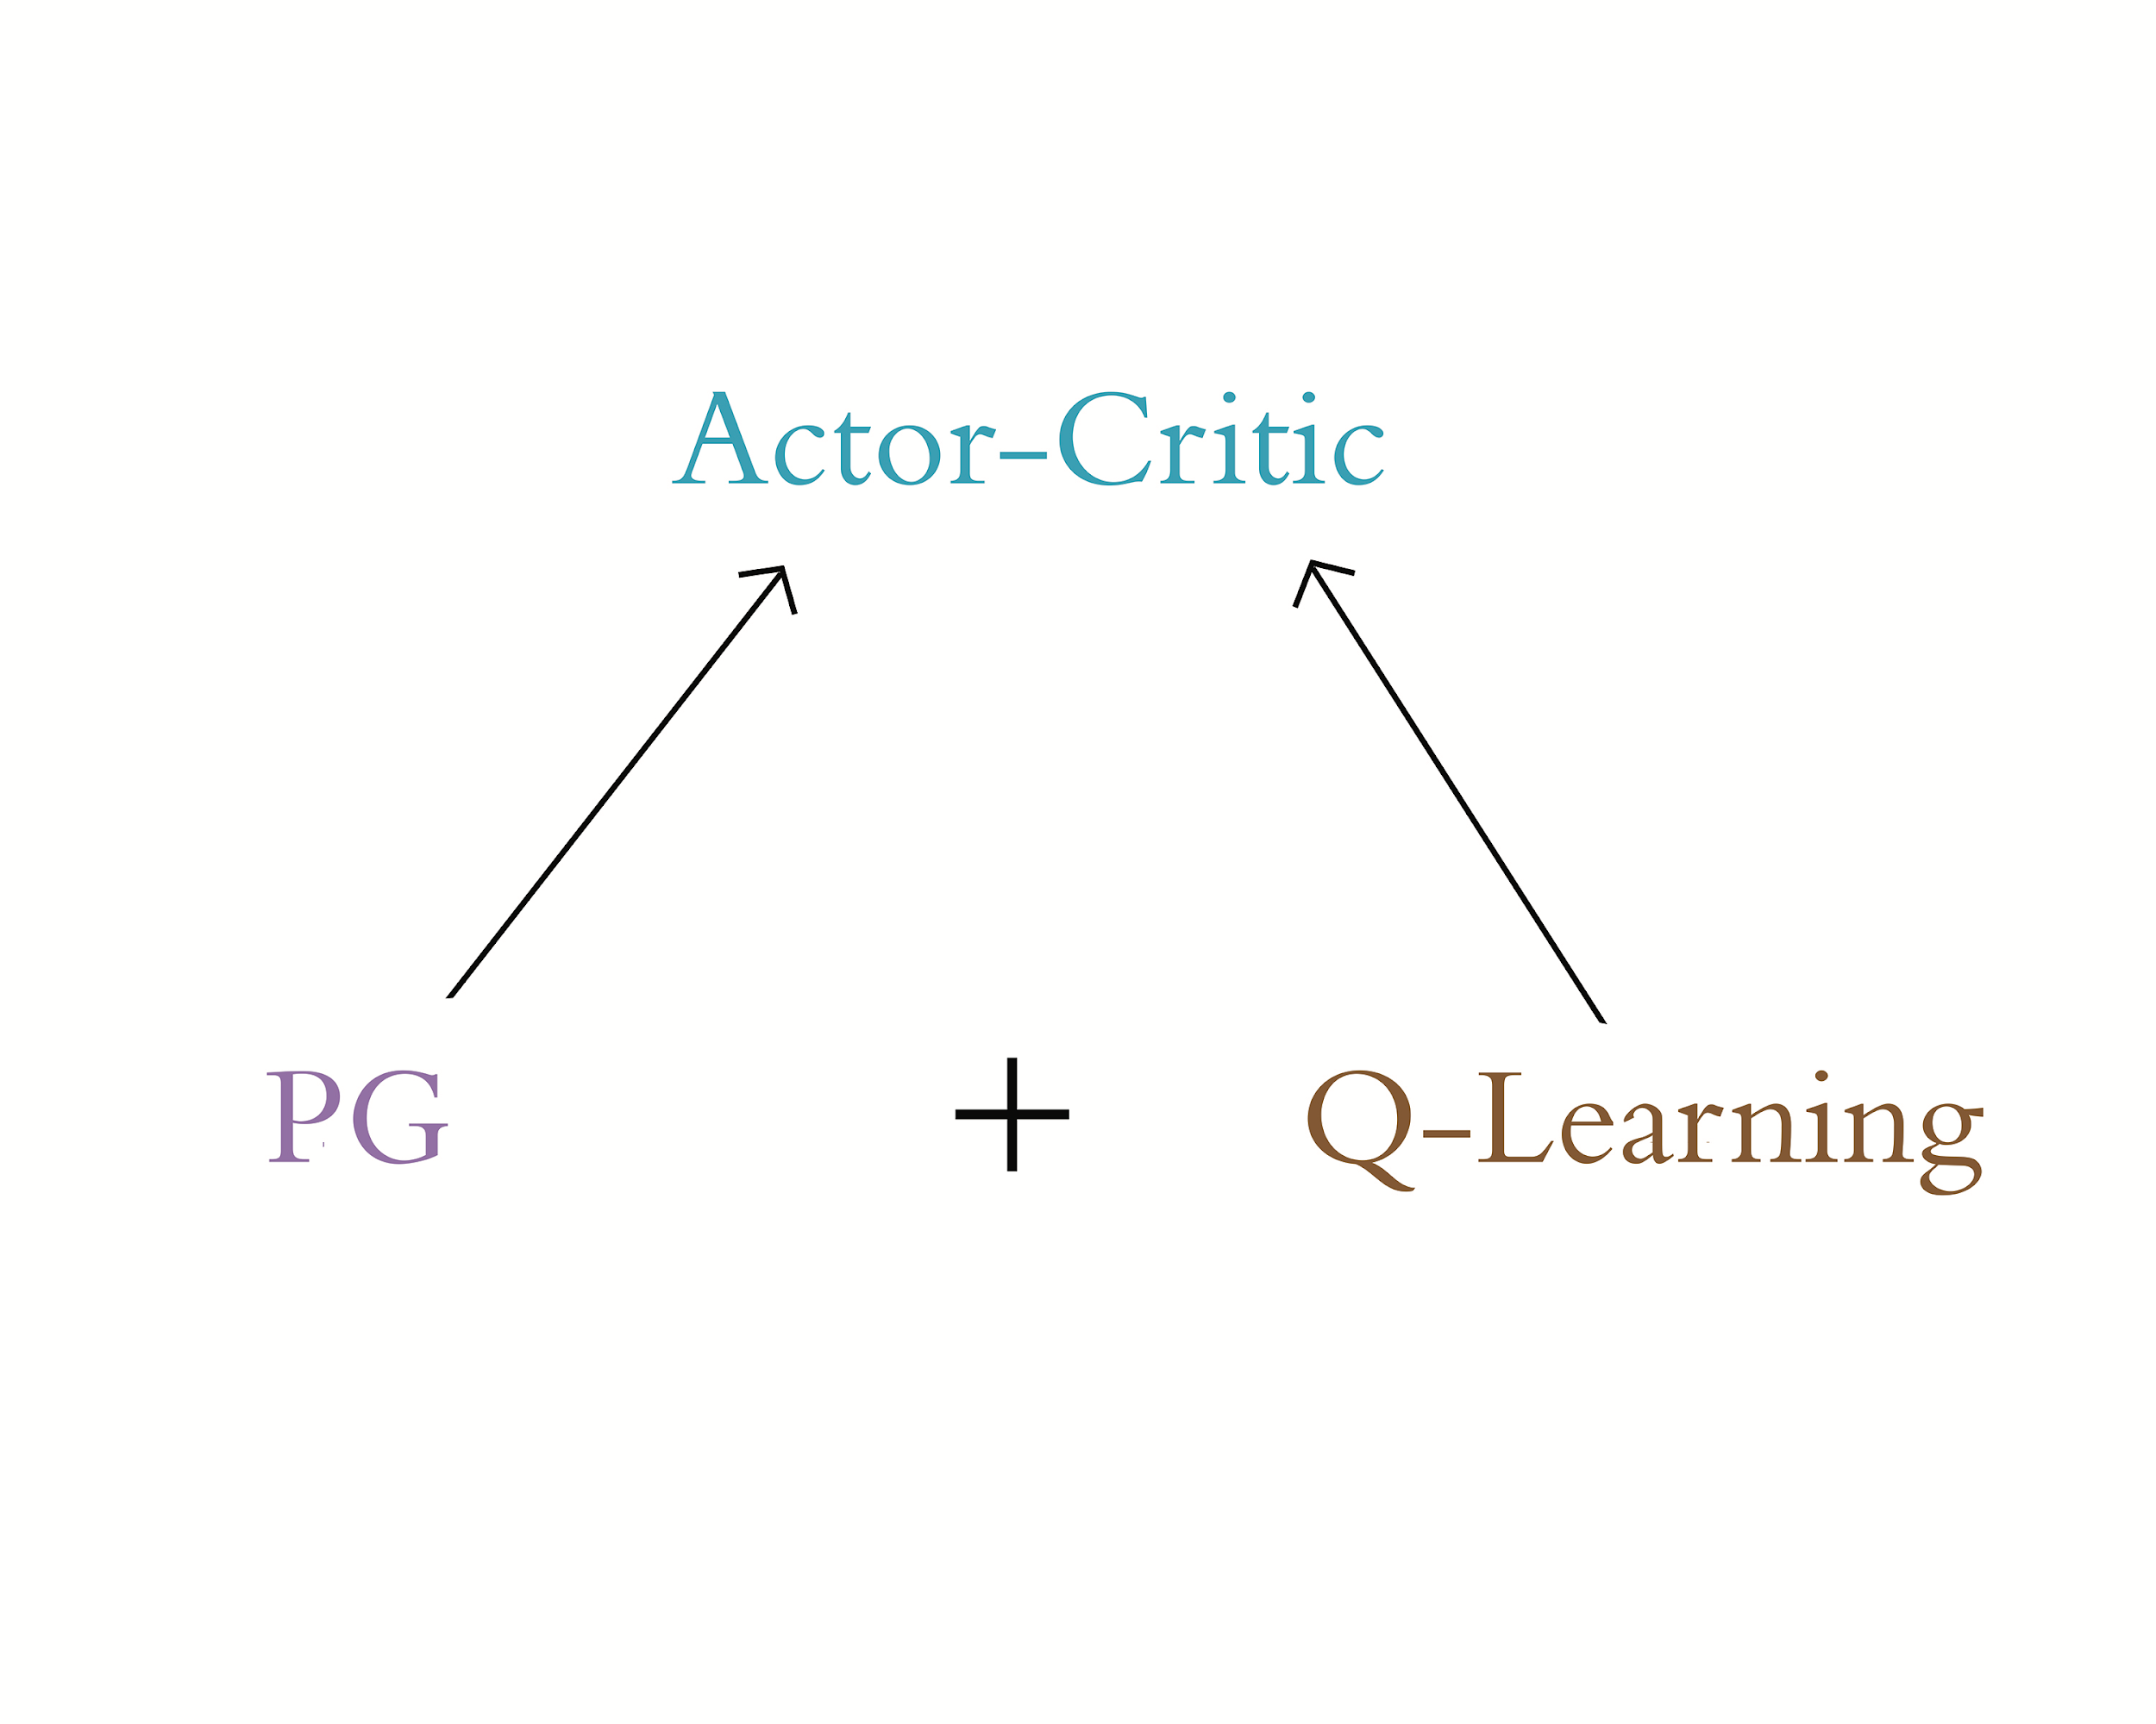

Slide 82
Chapter 14

Slide 83
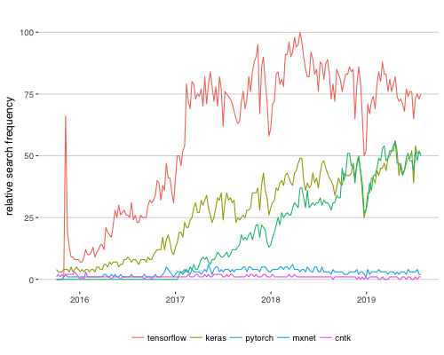
Deep Learning Library Popularity

Slide 84
TensorFlow 2.0
use layers (Keras) by default
autodiff Eager execution by default
JIT compiler for optimization, especially across devices
subclassing for unlimited flexibility, e.g.:
custom loss, optimizers, layers, training loops
repeating layers, blocks of layers
data pipelines and processing, e.g., tf.data, tf.io
portability:
TensorFlow Serving: high-performance systems across servers
TensorFlow Lite: for mobile or embedded devices
TensorFlow.js: for web browsers
to update code from 1.x: tensorflow.org/alpha/guide/migration_guide

Slide 85
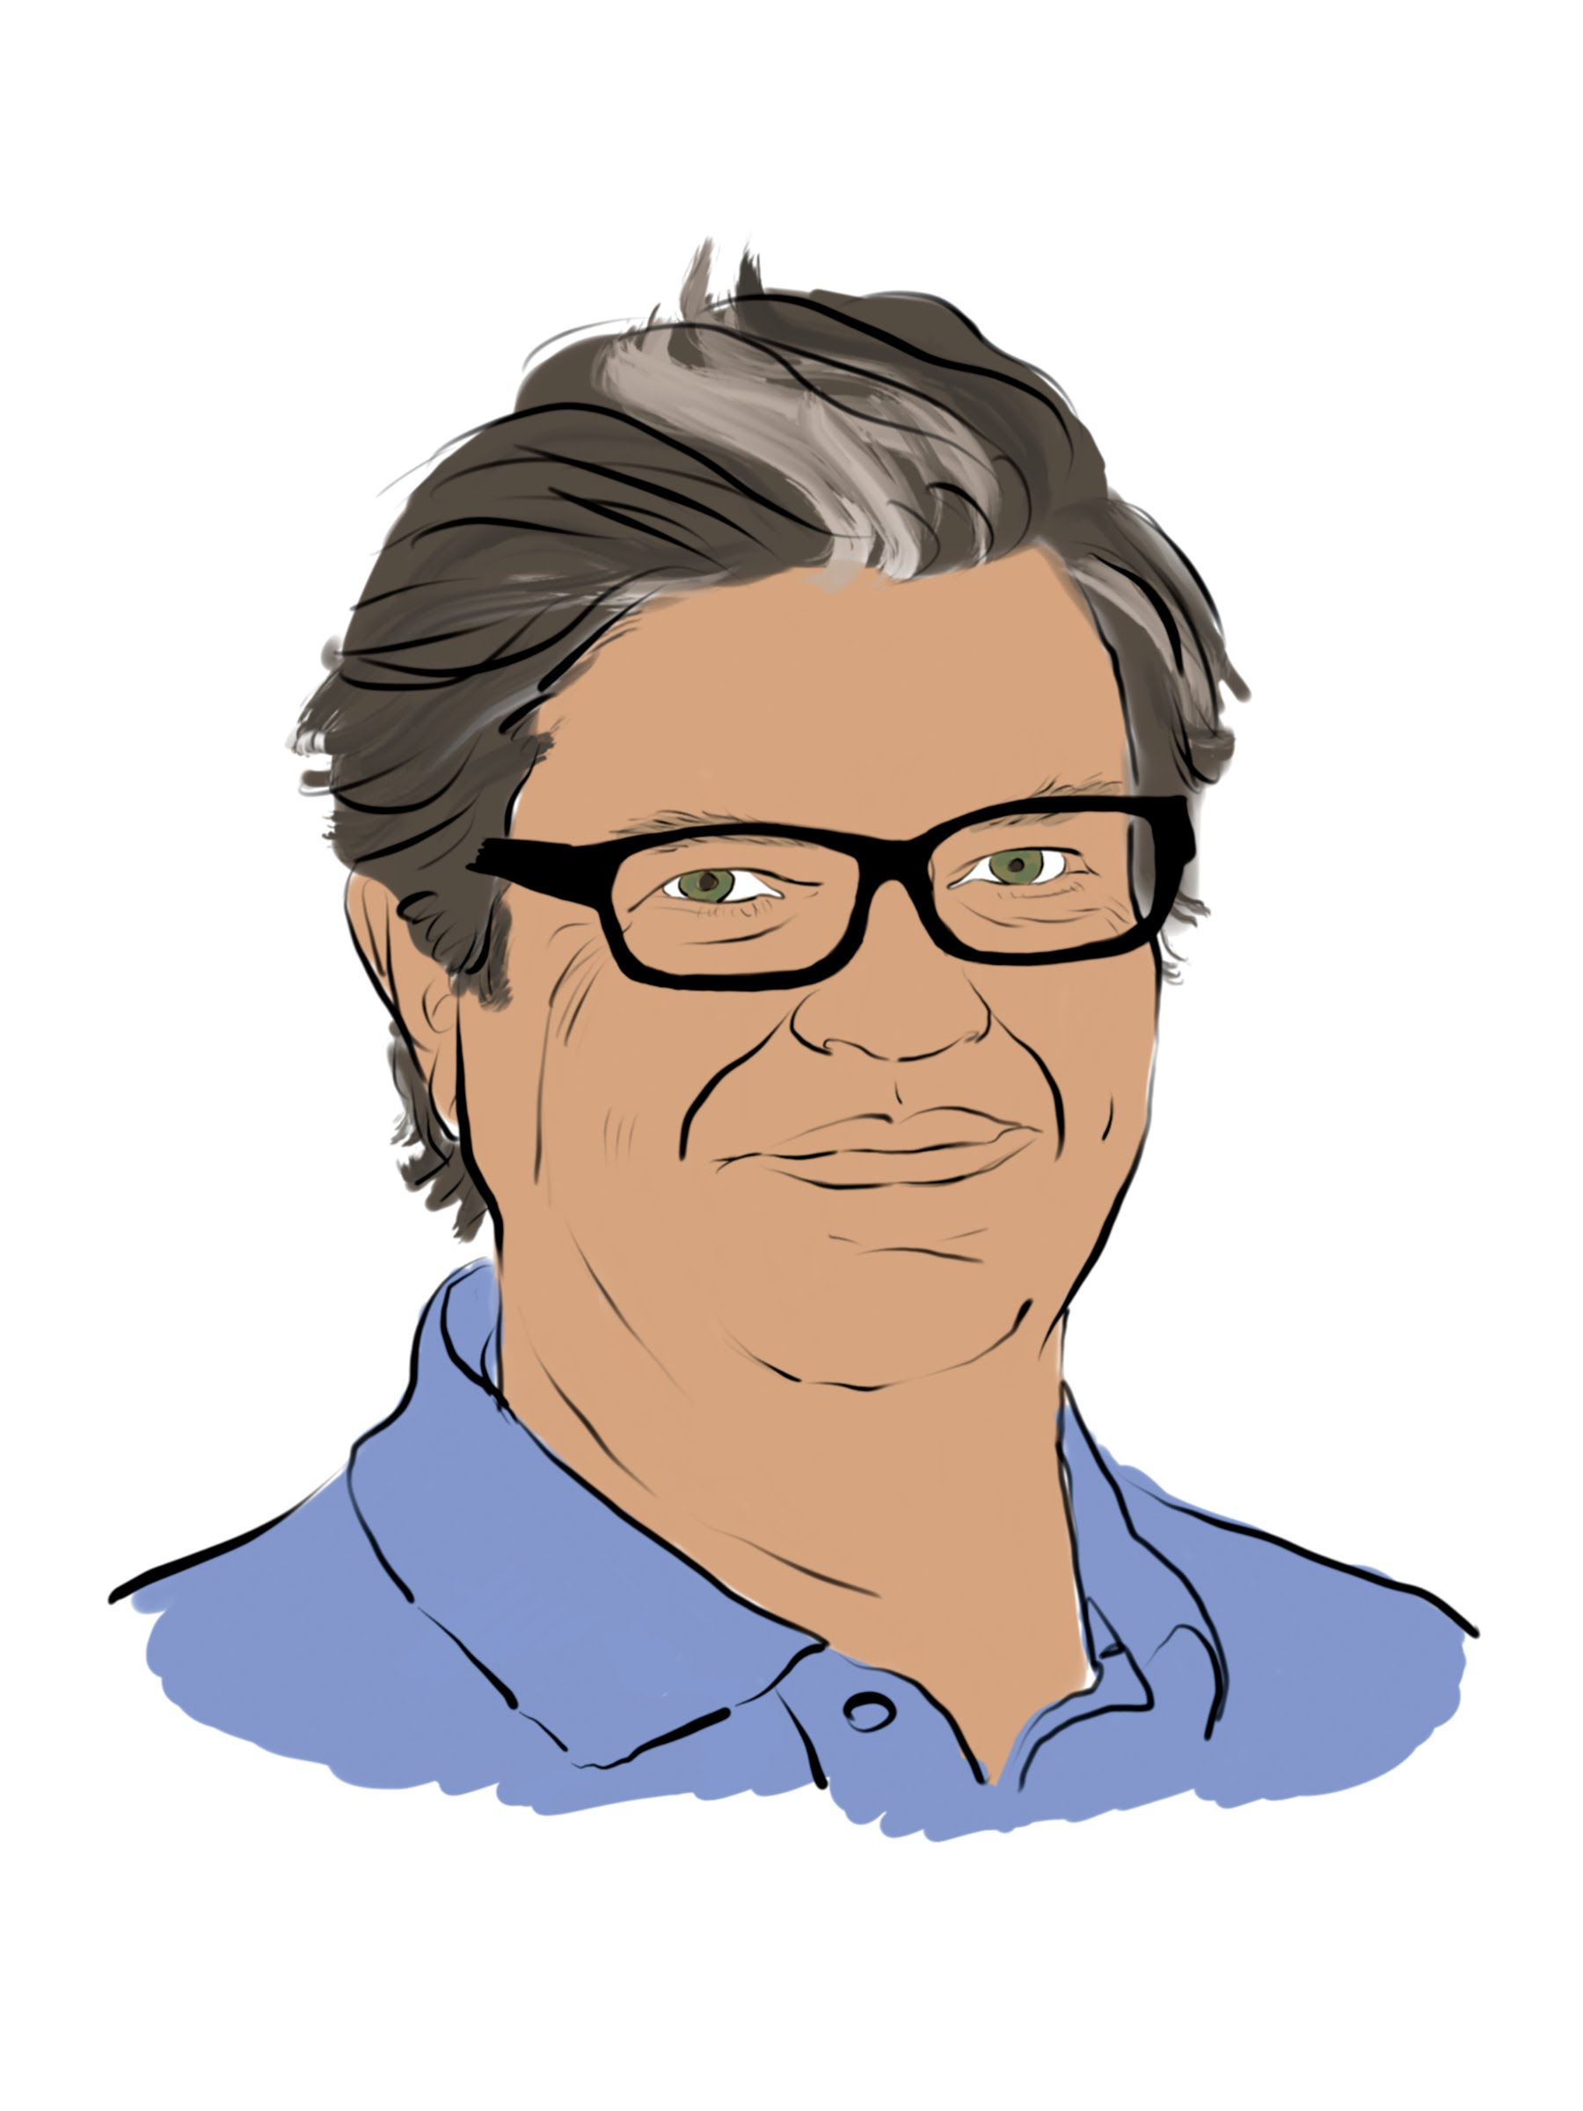
Yann LeCun

Slide 86
Deep Learning Library Popularity

Slide 87
PyTorch | TensorFlow
“NumPy”, optimized for GPUs | ported to Python from C++
dynamic auto-differentiation (autodiff) | static computational graph (prior to 2.0)
debugging is easier
fast.ai API | Keras API
 | more widely adopted
TorchScript Just-In-Time compilation | TensorFlow Serving, .js, Lite, tf.data, tf.io
better for interactively building models | better for production deployments

Slide 88
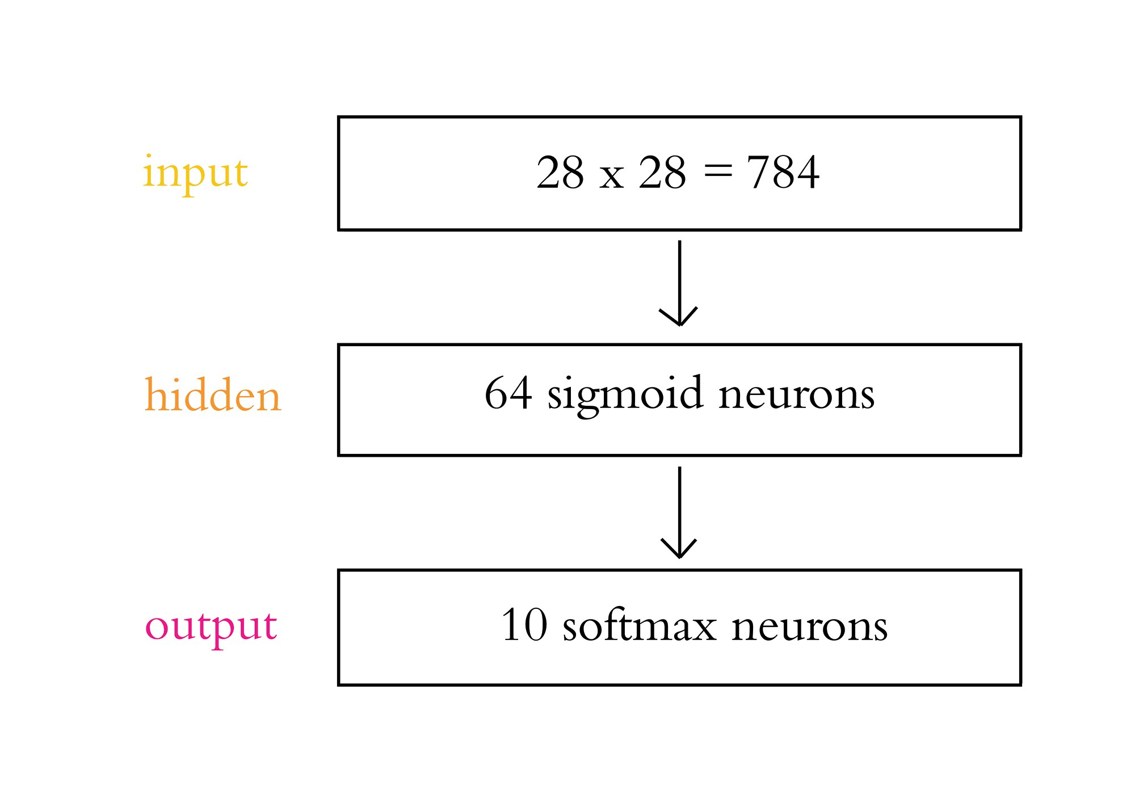

Slide 89
Hyperparameter Tuning
Parameter initialization
Cost function selection
Get above chance
Layers
Avoid overfitting
Learning rate
Batch size

Slide 90
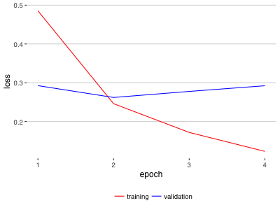
Overfitting

Slide 91
Automated Hyperparameter Search
Spearmint: github.com/JasperSnoek/spearmint
Hyperopt
Hyperas
kopt
talos

Slide 92
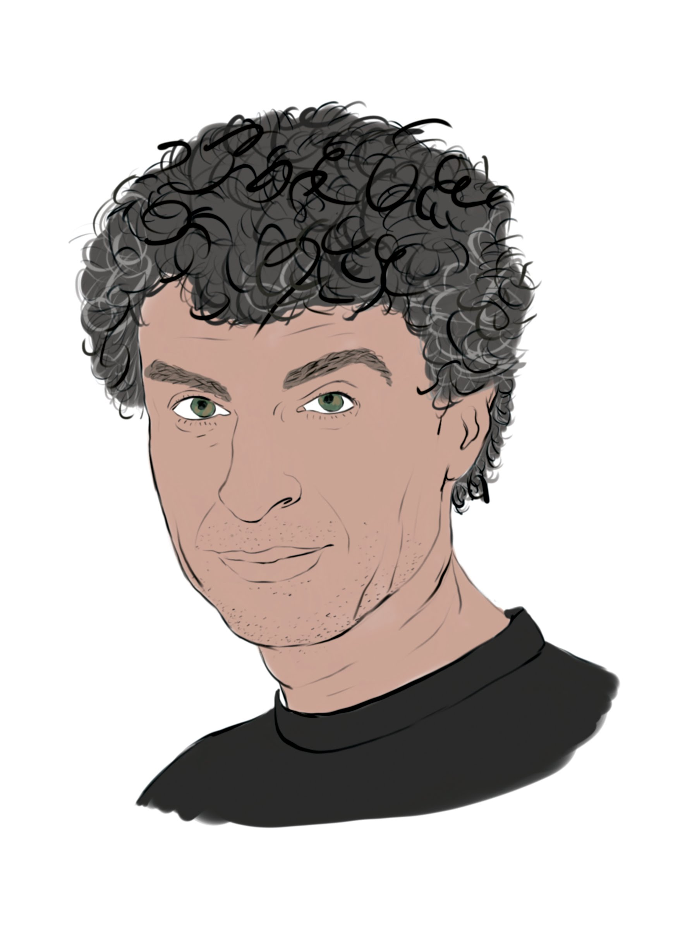
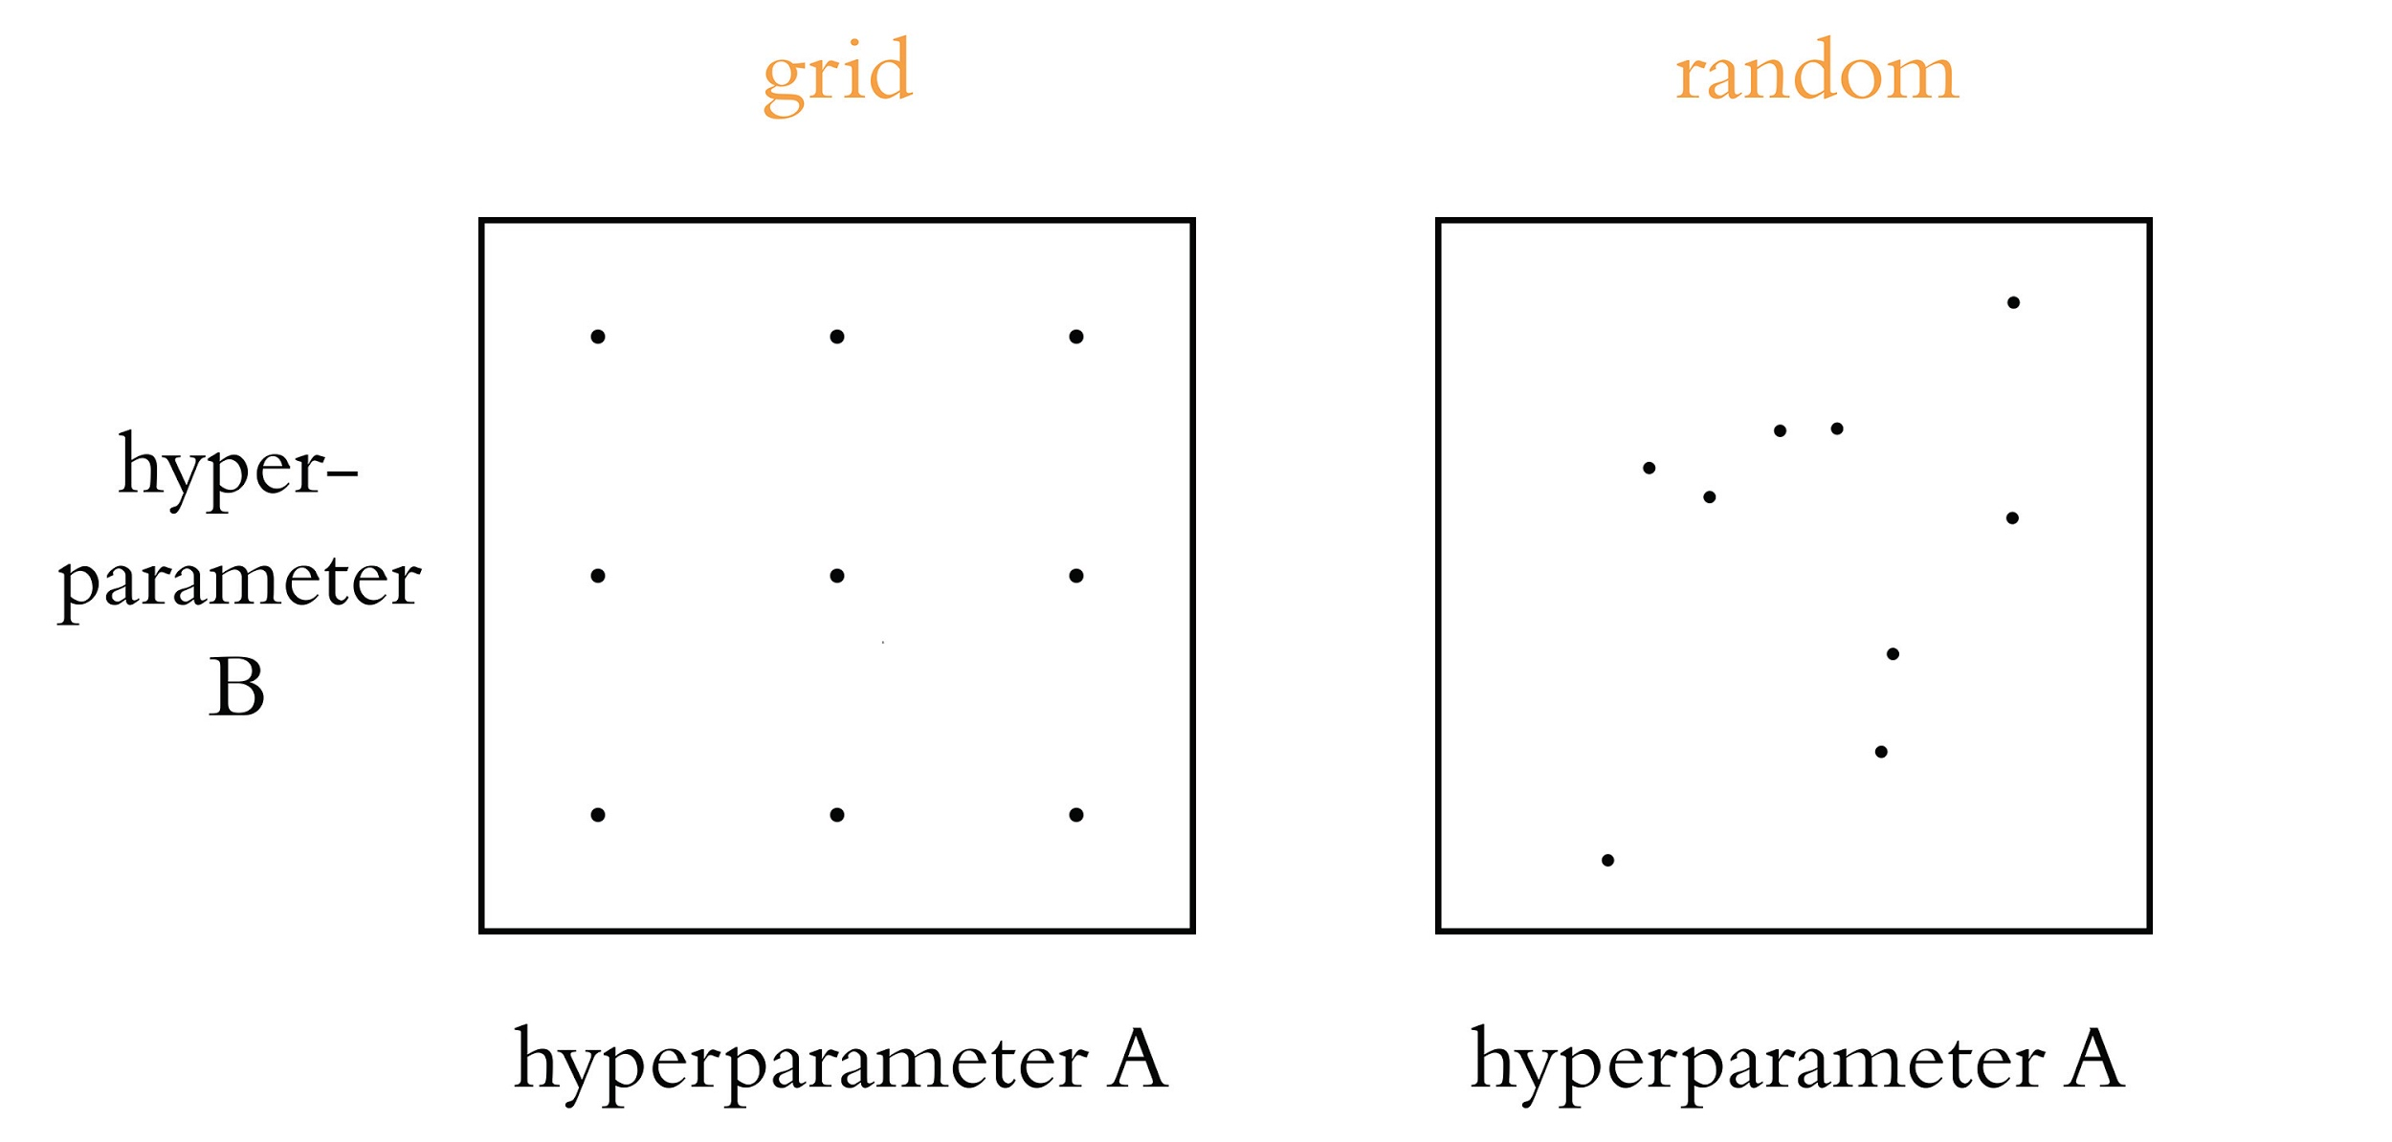

Slide 93
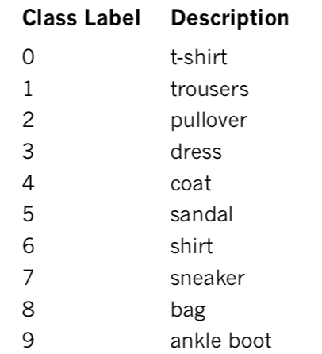
Fashion MNIST

Slide 94
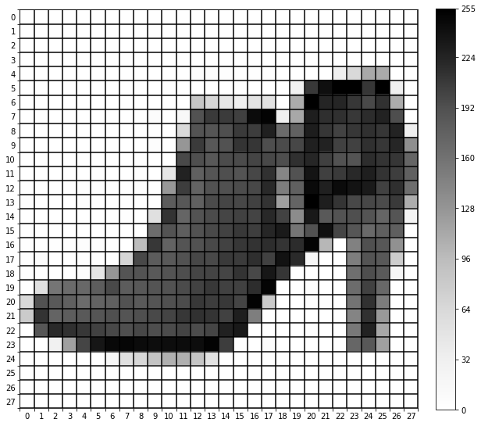
Fashion MNIST

Slide 95
Machine Vision Datasets
Kaggle: kaggle.com
Figure Eight: figure-eight.com/data-for-everyone
Luke de Oliveira: bit.ly/LukeData

Slide 96
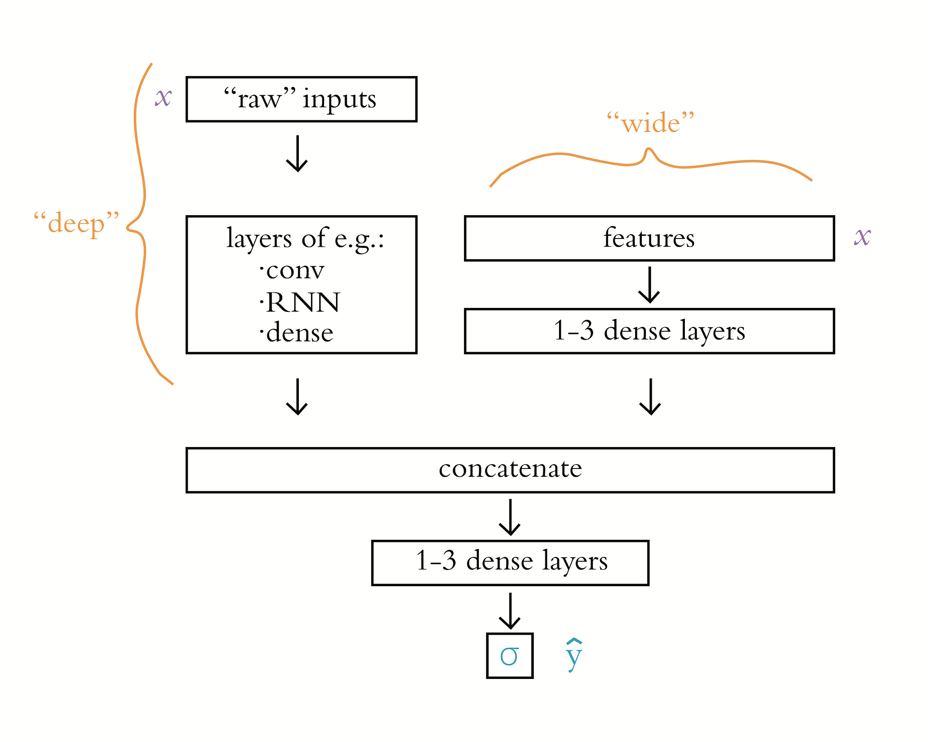
“Wide and Deep” Models

Slide 97
Social-Impact Domains
1. Equality and inclusion
2. Education
3. Health and hunger
4. Security and justice
5. Information verification and validation
6. Crisis response
7. Economic empowerment
8. Public and social sector
9. The environment
10. Infrastructure

Slide 98

Demis Hassabis and Yoshua Bengio

Slide 99
Climate Change Solution Domains
Electricity systems
Transportation
Buildings and cities
Industry
Farms and forests
CO₂ removal
Climate prediction
Societal impacts
Solar geoengineering
Tools for individuals
Tools for society
Education
Finance

Slide 100
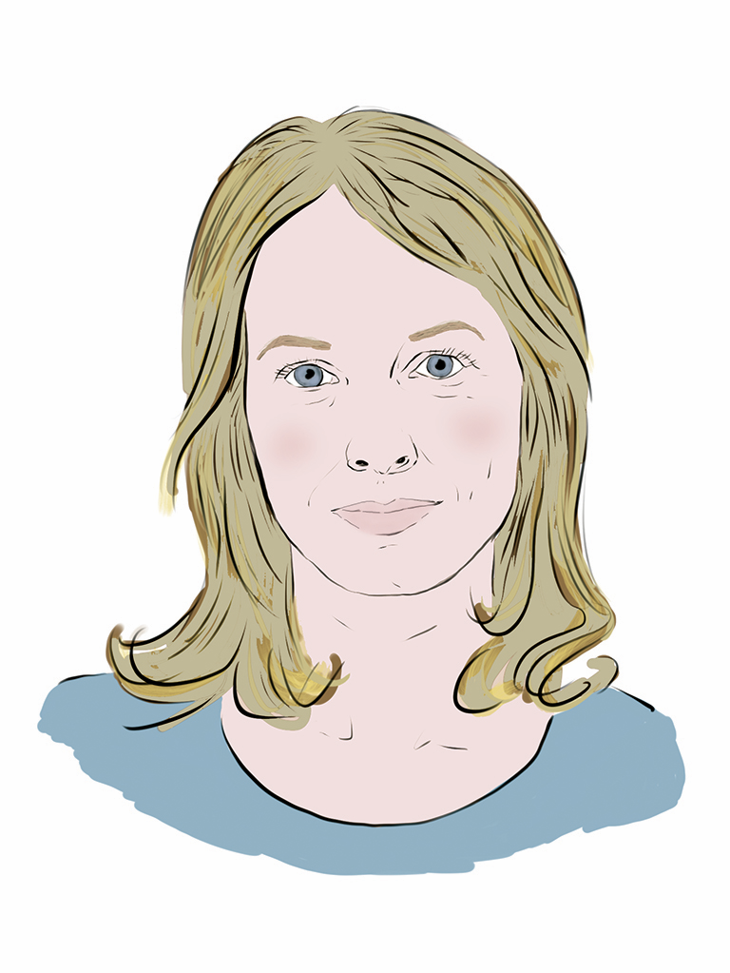
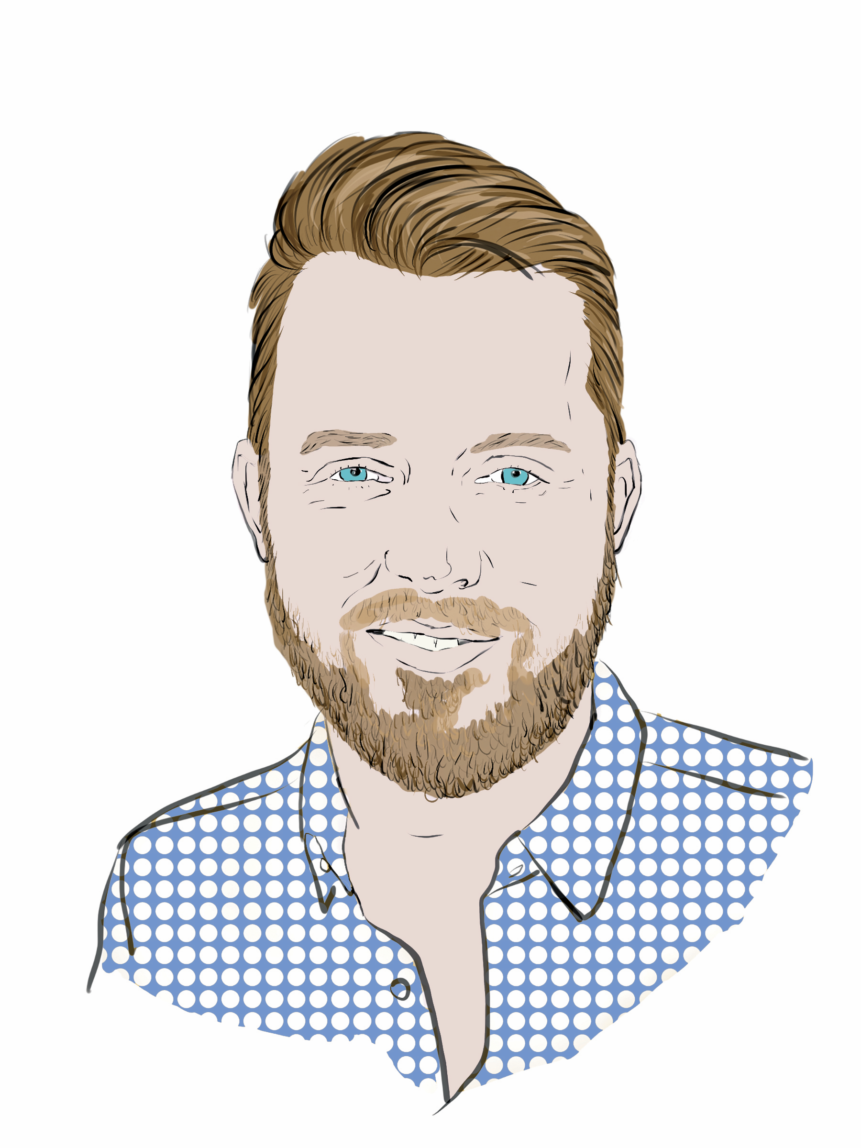
Aglaé Bassens and Grant Beyleveld

Slide 101


